Slide 1
Workshop "Robust and Reliable VLSI Circuits
Presents Talk on
High-Performance Inverter-Based AFE Design Methodologies for Wireline/Optical Receivers
Neeraj Mishra
Faculty Member
EEE Department
BITs Pilani, Pilani Campus

Slide 2
Bio-Sketch
Name: Neeraj Mishra
Faculty Member: EEE Department BITs Pilani, Pilani Campus. (04 Dec 2024-)
Senior Researcher: Analog Mixed Signal IC Designer focus on high speed CMOS Design at ID Lab of imec & Ghent University Belgium (1 April 2023-20 Nov 2024)
Post-Doc: ADVISE Group, ESAT Department, KU Leuven ( Nov 2021-Nov 2022). (QS World = 76th Rank, QS Electrical & Electronics =39th Rank).
Research Topic: Radiation-hardened Time-to-Digital Conversion (RADTIME).
Advisor: Prof. dr. ir. Paul Leroux.
PhD : IIT Roorkee (Visvesvaraya PhD Scheme for Electronics & IT) (2015-2021). (QS World = 369th Rank, QS Electrical & Electronics = (150-200)^{th} Rank)
Research Topic: High-Performance Ring Oscillator Using Separately Driven Inputs.
Advisor: Prof. Anand Bulusu.
M Tech : IIT Roorkee (2013-2015). (Gate Rank 346 in ECE)
Research Topic: Mechanical Stress aware design and layout of basic Analog building blocks.
Advisor: Prof. Anand Bulusu.
Job : (a) Engineer in Alcatel and Lucent Managed Solution Limited. (March 10 - May 13).
(b) Engineer in Railtel Corporation of India Limited (PSU Under Ministry of Railways). (June 08 - Feb 10).

Slide 3
Areas Covered in this Talk
Motivation
Importance of Wireline/Optical Links
Wireline Link Fundamentals
Role of Equalizers in Wireline/Optical Links
Optical Transceiver Basics
Criticality of Optical Receiver Design
Inverter-Based Design for Bandwidth & Gain
Conclusion
Notes:
High-Performance Wireline & Optical Links: Fundamentals to Advanced Design
Presentation Roadmap 🚀
1️⃣ Why This Matters?
We live in a world where data moves at lightning speed—whether it's cloud computing, AI, or high-speed communication networks.
Understanding high-performance wireline and optical links is crucial for modern communication systems.
The goal? Reliable, high-speed, and power-efficient data transmission.
2️⃣ Wireline vs. Optical Links
Think of wireline links as super-fast highways made of copper, while optical links are like fiber-optic bullet trains.
Each has its strengths—wireline is robust in short-reach applications, while optical links shine for long-distance, high-bandwidth communication.
We’ll compare their losses, speed, and noise handling capabilities.
3️⃣ How Do Wireline Links Work?
Fundamentals of signal transmission, reflections, losses, and bandwidth limitations.
What happens when a signal travels down a PCB trace or a cable?
Why attenuation and distortion are key concerns in wireline systems.
4️⃣ Equalizers: The Game-Changers!
Imagine trying to hear a distant sound—sometimes you need a hearing aid (amplifier), and other times you need to remove noise (equalization).
Equalizers compensate for frequency-dependent losses in both wireline and optical links.
We’ll look at CTLEs, DFE, and FFE and their roles in signal recovery.
5️⃣ Inside an Optical Transceiver
Breaking down an optical transceiver:
🔹 Laser Driver & Modulator – Converts electrical signals to optical.
🔹 Optical Fiber – The transmission medium.
🔹 Photodetector & Receiver – Converts optical signals back to electrical.
Where do losses and impairments occur?
6️⃣ Why Optical Receiver Design is Critical?
The receiver front-end is the heart of an optical link—small distortions here can cause huge errors.
We’ll discuss noise, sensitivity, bandwidth limitations, and dynamic range trade-offs.
What makes TIA (Transimpedance Amplifier) design so challenging?
7️⃣ Pushing the Limits: Inverter-Based Design for Bandwidth & Gain
Inverter-based analog front-ends are an innovative way to optimize high-speed optical receivers.
We’ll explore how inverters can provide high gain, better bandwidth, and lower power consumption.
Practical design insights and how they compare to traditional differential pairs.
8️⃣ Wrapping Up & Key Takeaways!
Summarizing key learnings and the future trends in high-performance link design.

Slide 4









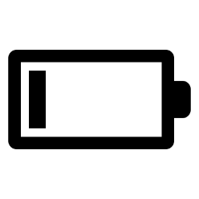




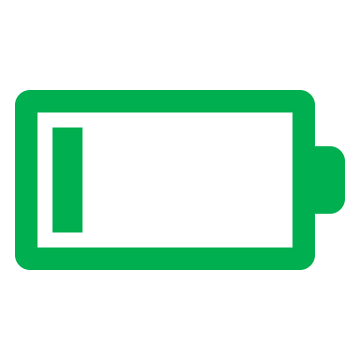


Motivation
Next-generation datacenter communication links require:
100+ Gb/s optical links are in high demand for 400G-DR4/FR4/LR4 and 800G-DR8 ethernet applications
100+
Gb/s/λ
energy
Notes:
With the big-bang of the internet powering AI/ML, video conferencing, IoT, blockchain and cloud storage applications have continuously increased the demand on data-centers with faster, lower-cost and energy-efficient solutions. Such solutions for optical links, in particular are in high demand for 100+ Gb/s links. This was also heavily emphasized from yesterday’s keynote talk by Dr. Eric Carl from Intel that moving the data out of the package and going optical as early as possible with high density is required to meet such demand. Our work in particular focuses on the 400Gig and 800Gig ethernet applications.
🌐 Why do we need faster datacenter communication links?
Imagine you’re streaming a movie, making a video call, or using cloud storage. All of this happens because massive data centers process and transfer information at lightning speed. But as our internet usage explodes, today’s infrastructure is struggling to keep up.
🔺 Speed matters!
Modern applications like AI, cloud computing, and big data demand 100+ Gb/s per wavelength to handle massive amounts of information efficiently. Without this, networks slow down, causing bottlenecks.
🔻 But speed isn’t everything...
If we only focus on increasing speed, it could lead to higher costs and power consumption, making these systems unsustainable. The challenge is to increase speed while reducing cost and energy use—a balancing act that engineers are solving with smarter optical communication technologies.
⚡ What’s the future?
The industry is moving toward 400G and 800G Ethernet links (like 400G-DR4, FR4, LR4, and 800G-DR8) to meet this demand. These technologies enable faster, more energy-efficient data centers, ensuring smooth and seamless digital experiences for all of us.
💡 Why does this matter to you?
Because everything from your favorite apps to future innovations in AI, cloud, and IoT depends on how well we solve these challenges today!

Slide 5
Importance of Wireline/Optical Links
Notes:
Now lets see the assembled prototype

Slide 6
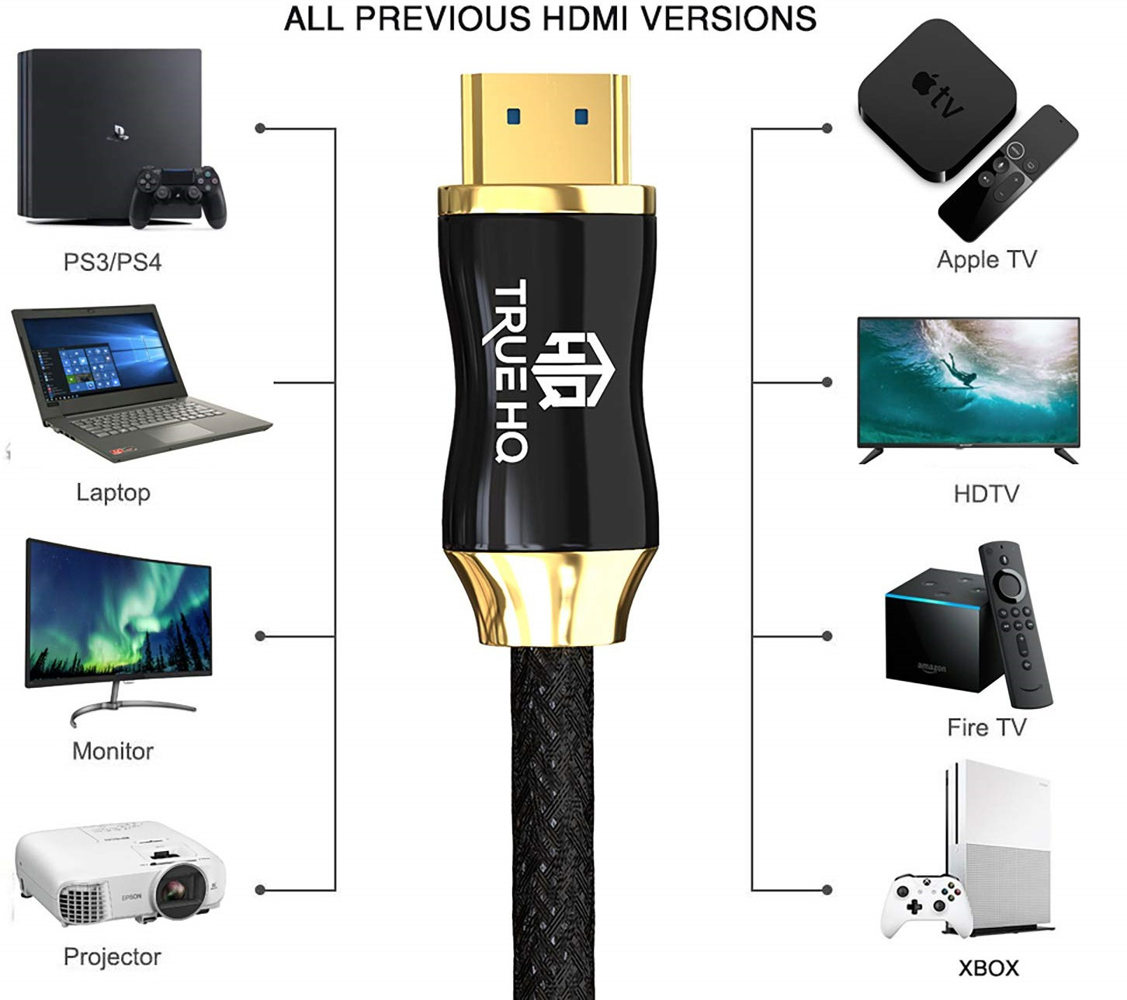
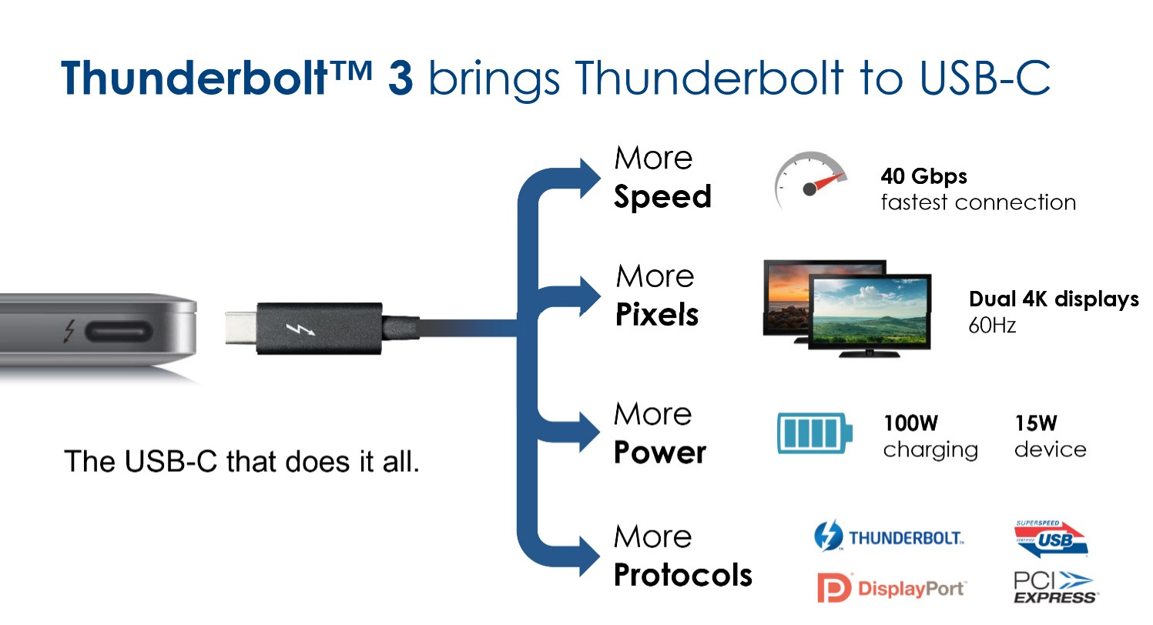
Consumer High-Speed Serial Links
HDMI
Courtesy: Internet
Examples are e. g. HDMI™ and Thunderbolt™ infrastructure
Both are point-to-point links
Notes:
Here are some concise speaker notes you can use while presenting the "Consumer High-Speed Serial Links" slide:
Speaker Notes:
Introduction to High-Speed Serial Links
In modern consumer electronics, high-speed serial links play a crucial role in enabling efficient data transfer.
Two well-known examples are HDMI™ and Thunderbolt™.
HDMI™ Overview
HDMI (High-Definition Multimedia Interface) is widely used for audio-video transmission.
Connects devices like laptops, gaming consoles, projectors, and monitors to displays.
Supports high-resolution video, multi-channel audio, and features like ARC (Audio Return Channel).
Thunderbolt™ Overview
Thunderbolt™ 3/4 combines power, data, and display into a single USB-C connector.
Provides high-speed data transfer (up to 40 Gbps), supporting dual 4K displays @ 60Hz.
Enables device charging (up to 100W) and supports multiple protocols (USB, PCIe, DisplayPort).
Key Takeaways
Both HDMI and Thunderbolt are point-to-point serial links for high-speed communication.
HDMI is specialized for media, whereas Thunderbolt is versatile for power, data, and video.
Understanding these links helps in selecting the right interface for different applications.

Slide 7
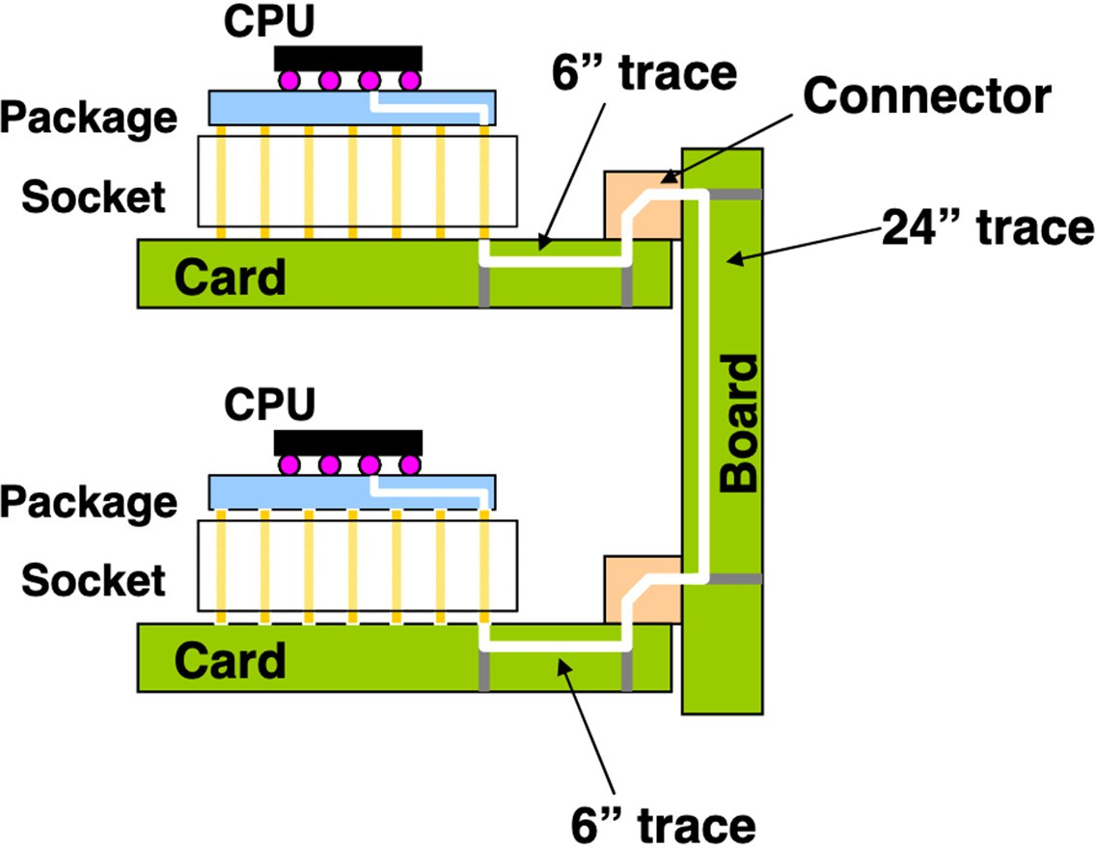

Industry High-Speed Serial Links
Courtesy: Internet
Backplane and chip-to-chip (e.g. processor, memory, …)
Data center networks (e.g. Ethernet, fiber optical networks, … )
Notes:
Industry High-Speed Serial Links
📌 Where are high-speed links used?
Backplane & chip-to-chip communication (e.g., processor, memory)
Data center networks (e.g., Ethernet, fiber optics)
📌 Challenges in high-speed links
Signal degradation over long PCB traces
Loss, reflections, and crosstalk affecting data integrity
Need for equalization and advanced receiver design
📌 Why optical links?
Lower loss & higher speed for long-distance communication
Essential for scaling modern data centers

Slide 8
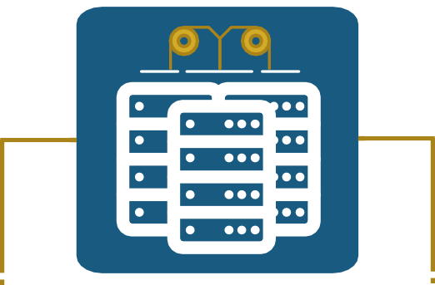
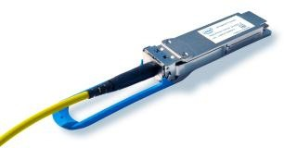
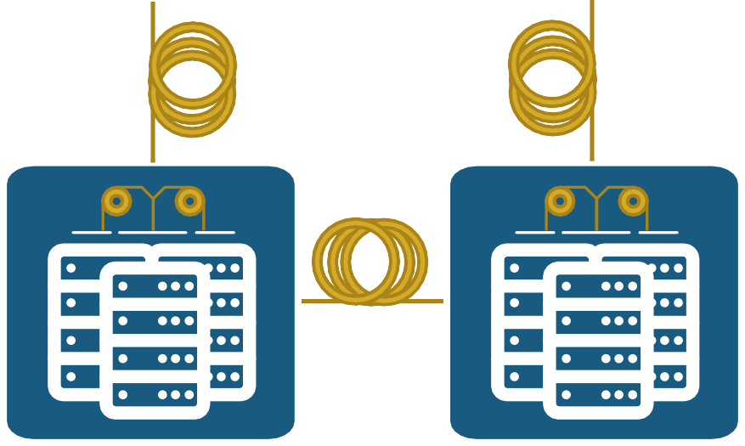
Datacenters
©Intel
DC
>100Km
Pluggable Module
Deployment
  Long haul terrestrial and undersea
  Metro: Between datacenters, central offices
  Datacenters: Between racks, servers
  Within servers and system-on-chips (SoCs)
<100Km
DC
DC
Co-located
Notes:
Datacenters & Optical Interconnects
📌 Why are optical links essential?
Enable high-speed, low-latency communication.
Scale efficiently across different deployment distances.
📌 Types of Optical Interconnect Deployment:
Long-haul (>100Km): Terrestrial & undersea fiber for global connectivity.
Metro (10-100Km): Between datacenters & central offices.
Intra-datacenter (<10Km): Connecting racks & servers.
On-chip & within servers: Short-range high-speed links (e.g., SoCs).
📌 Pluggable Optical Modules:
Provide scalability & flexibility for upgrading datacenter links.
Support hot-swapping to adapt to bandwidth demands.

Slide 9
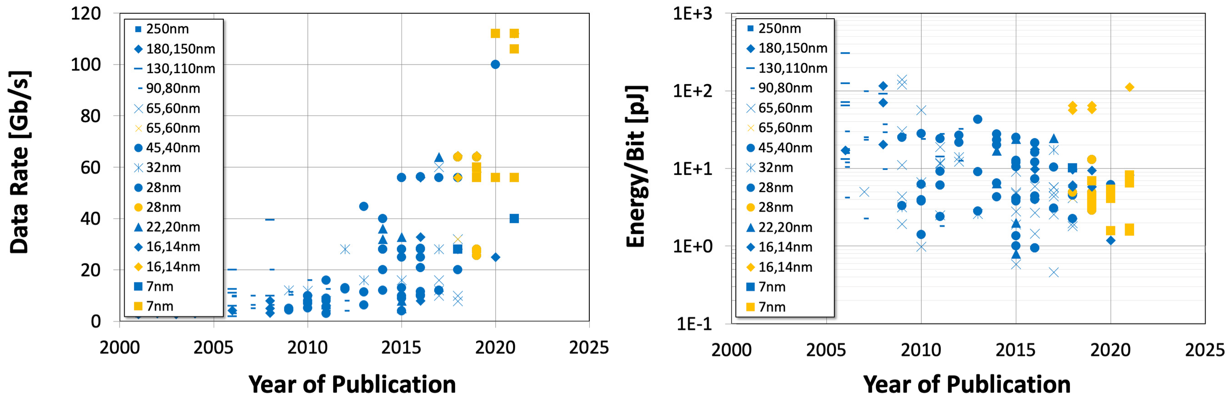
Trend of Ever-Increasing Data Rate
28nm: NRZ
28nm: PAM4
PAM4 based transceivers drive the data rate beyond 100GBit/s
7nm CMOS technology enables power-efficiency <10pJ/conv.
Details of the wireline transceiver survey: [1], [2]

Slide 10
Wireline Link Fundamentals
Notes:
Now lets see the assembled prototype

Slide 11

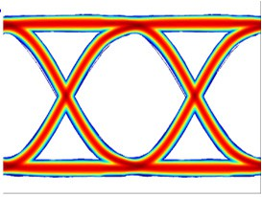
Basic Wireline Link - SerDes
TX
RX
R_{T}
Z_{L}
R_{T}
MUX
DEMUX
Eq.
Driver
Eq.
CDR
PLL
PLL
Transmitter (TX): Converts the digital (time-discrete) data into a (time-continuous) analog electrical signal → D-to-A conversion
Channel: Transmission media for the analog signal
Receiver (RX): Digitizes the analog signal back to bits (quantize in voltage and time) → A-to-D conversion
Serialize (TX) – Deserialize (RX) → “SerDes”

Slide 12
Anatomy of a Wireline Link
TX
RX
E S D
E S D
DMUX
Data In
MUX
FFE
Data
DRV
Channel
VGA
CTLE
DFE
Out
Clock Gen (BUFs, DIVs)
CDR
Freq Gen (PLL w/ LCVCO)
Notes:
📌 Why is this important?
Enables high-speed data transmission over electrical channels.
Compensates for signal degradation due to loss, noise, and dispersion.
📌 Key Components:
Transmitter (TX)
MUX: Serializes multiple data streams into a high-speed output.
FFE (Feed-Forward Equalization): Pre-emphasizes signal to combat channel loss.
DRV (Driver): Buffers and drives the signal onto the channel.
Clock Gen (BUFs, DIVs): Generates timing signals for precise data transmission.
Channel
The medium (PCB traces, cables) that introduces loss, reflections, and interference.
Receiver (RX)
VGA (Variable Gain Amplifier): Adjusts signal amplitude.
CTLE (Continuous-Time Linear Equalizer): Compensates for frequency-dependent loss.
DFE (Decision Feedback Equalizer): Cancels post-cursor ISI (Inter-Symbol Interference).
CDR (Clock and Data Recovery): Extracts timing and aligns received data.
DMUX: Converts high-speed serial data back into multiple parallel streams.
📌 PLL & Frequency Generation:
Generates precise clock signals to maintain synchronization between TX and RX

Slide 13
FinFET Impact on Wireline Circuits & Systems
Amplifier Topologies
TX
Inductor Design
Calibration
R
X
Comparator Calibration
Driver Topology
E S D
E S D
R_{OUT} Calibration
DMUX
Data In
MUX
FFE
Data
DRV
Channel
VGA
CTLE
DFE
Out
Classic Mixed-Signal vs ADC + DSP
Clock Gen (BUFs, DIVs)
CDR
Freq Gen (PLL w/ LCVCO)
Clock Timing Calibration
Clock Timing Calibration
Analog or Digital PLL

Slide 14
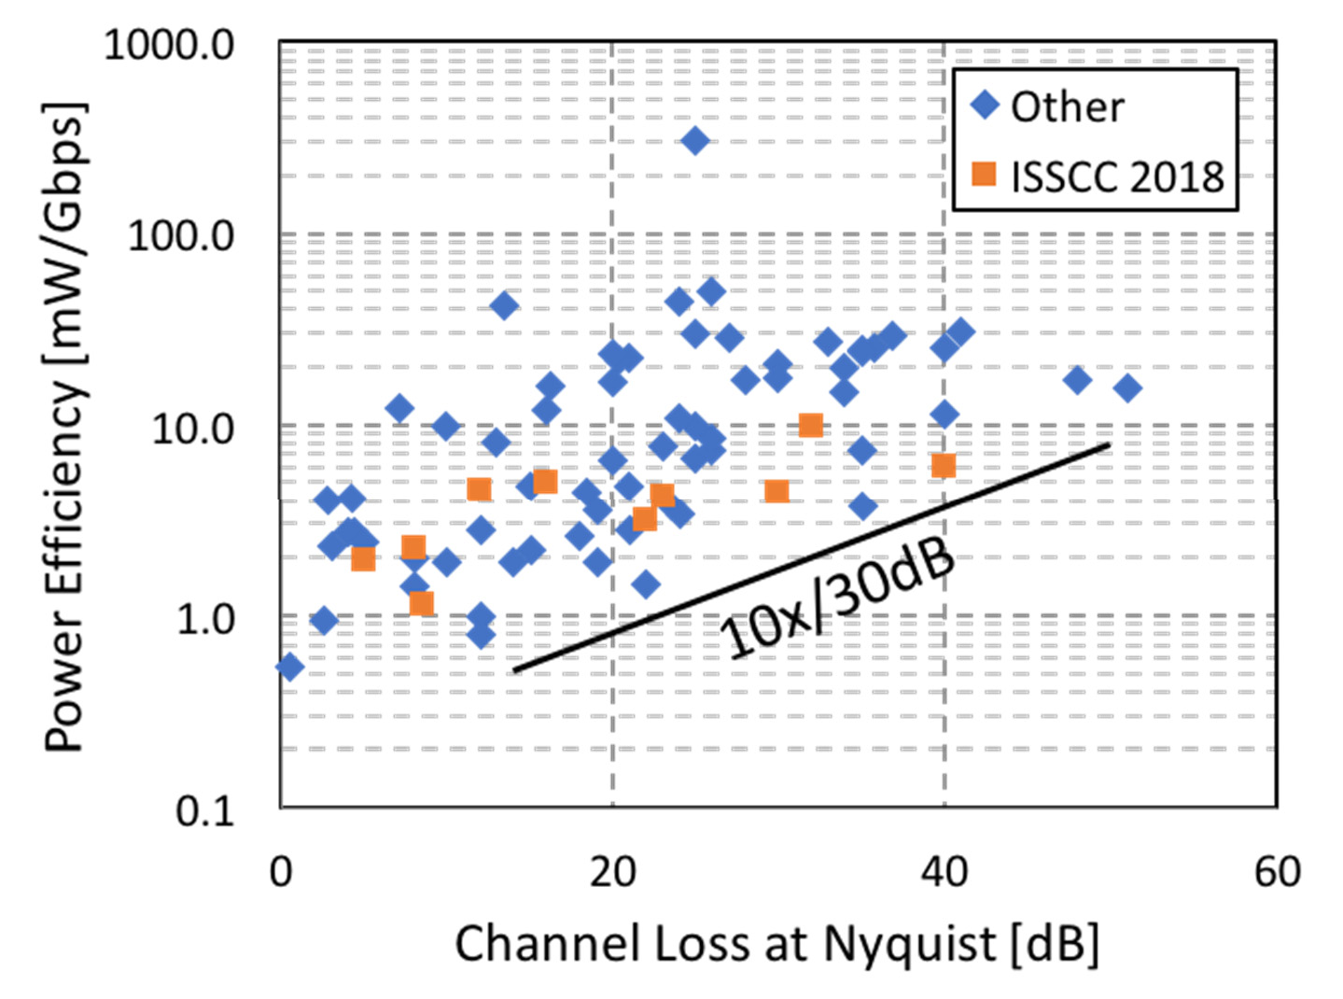
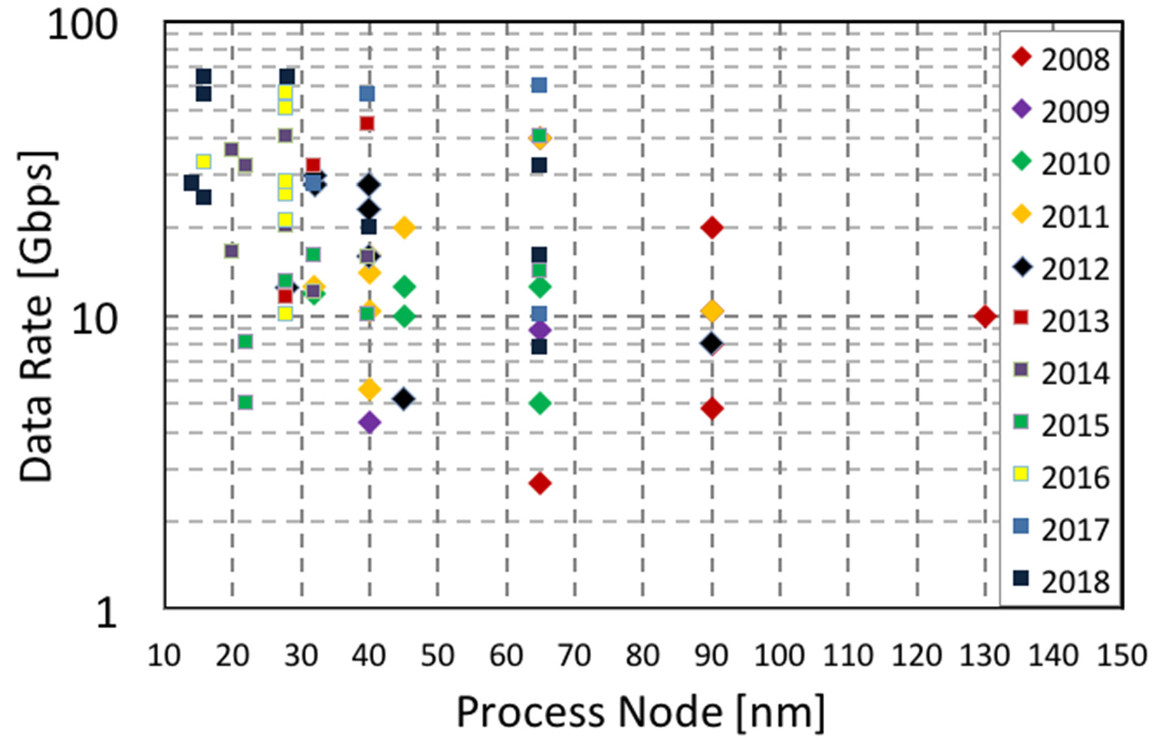

Wireline Research at ISSCC
100+ Gb/s (2019–2020)
[ISSCC Trends 2018]

Slide 15
Wireline/Optical Links Performance Parameters
Notes:
Now lets see the assembled prototype

Slide 16
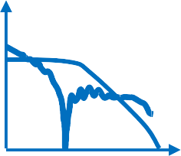
Electrical I/O Channel Loss → ISI
G(f)
f
Channel
Data
TX
RX
□ Frequency-dependent loss in Cu channel creates inter-symbol interference (ISI)
Loss increases at high data rates
Loss increases with length of interconnect
Equalizer helps but consumes power
Notes:
Electrical I/O Channel Loss → ISI
📌 Why does this matter?
Signal integrity degrades due to channel loss, leading to Inter-Symbol Interference (ISI).
ISI causes data-dependent jitter and bit errors in high-speed links.
📌 Key Takeaways:
🔺 Frequency-dependent loss in Cu interconnects creates ISI.
🔺 Loss increases at higher data rates.
🔺 Longer interconnects suffer more signal attenuation.
📌 Mitigation Strategy:
✔ Equalization (CTLE, DFE) helps compensate for loss but consumes power.
Understanding these effects is critical for designing high-speed, power-efficient wireline receivers. Let me know if you need refinements! 🚀

Slide 17
Inter Symbol Interference (1)
Desired 1 bit
1
Vth
0
… 0⁰ 0
0
0 …
0100000000
…0001000…
Single bit response (SBR)
LPF
A typical channel is a low-pass filter (LPF).
Inter symbol interference (ISI) disrupts signaling.
Notes:
1️⃣ Electrical I/O Channel Loss → ISI (Inter-Symbol Interference)
🎤 Analogy: Singing Through a Wall
Imagine you're at a concert, but you're standing outside the hall.
If the wall is thin, you can still hear the song clearly.
If the wall is thick, the sound gets muffled—high-pitched notes fade out first, while low-pitched sounds remain somewhat audible.
🟢 In high-speed links, the copper channel acts like that wall.
High frequencies (sharp transitions in signals) experience more loss.
The signal gets distorted, leading to Inter-Symbol Interference (ISI)—previous bits "leak" into the next ones.
🚗 Another Analogy: Driving on a Foggy Road
Imagine driving on a highway at low speed—you can see road signs clearly.
But at high speed, things blur, and you start confusing one sign with another.
The longer the road (interconnect length), the harder it is to see clearly.
🟢 Equalizers = Fog Lights → They help recover details but consume extra power.

Slide 18
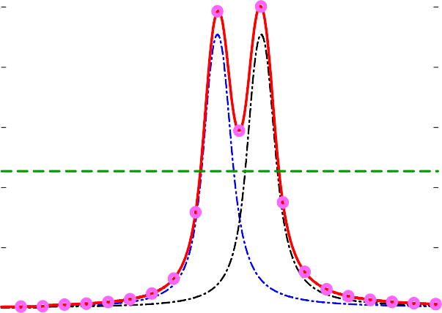


Inter Symbol Interference (2)
1
1
Error!
Vth
1
0
… 0⁰
0
0_{0 …}
…0001 10…
0101000000
1
Error!
LPF
A typical channel is a low-pass filter (LPF).
Inter symbol interference (ISI) disrupts signaling.

Slide 19
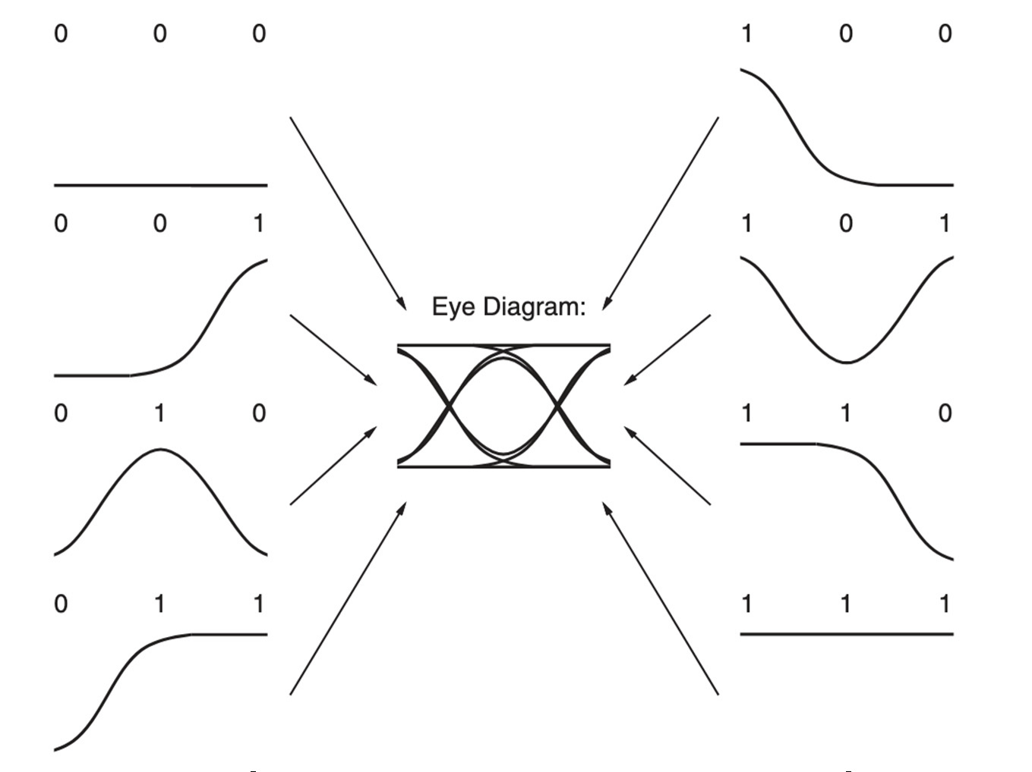
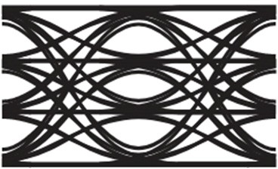
NRZ and PAM4 Eye Diagram
NRZ eye diagram
PAM4 eye diagram
^{V}out,TX
D1 D0
Full Scale (FS)
1
2/3
1/3
0
1 1
1 0
0 1
0 0
1
^{V}out,TX
0
1T_{bit} =1UI
1T_{bit} =1UI
(UI ≡ unit interval)
Eye diagram construction by overlaying waveform segments
Non-return-to-zero (NRZ) → 1bit/symbol, PAM4 → 2 bits/symbol
Notes:
NRZ vs. PAM4 Eye Diagrams
📌 Why does this matter?
Eye diagrams visualize signal integrity and timing margins in high-speed links.
NRZ (Non-Return-to-Zero) uses 1 bit per symbol, while PAM4 (Pulse Amplitude Modulation 4) packs 2 bits per symbol for higher data rates.
📌 Key Takeaways:
🔹 NRZ Eye Diagram
✔ Two levels (0 & 1) → Larger eye opening, better noise margin.
✔ Simpler to implement, robust against noise.
🔹 PAM4 Eye Diagram
✔ Four levels (0, 1/3, 2/3, 1) → Higher data rate at the same Nyquist frequency.
✔ Three eye openings → Smaller noise margin, more susceptible to distortions.
📌 Trade-off:
✔ PAM4 increases data bandwidth efficiency, but requires higher linearity and better equalization for signal recovery.
Let me know if you want refinements! 🚀

Slide 20
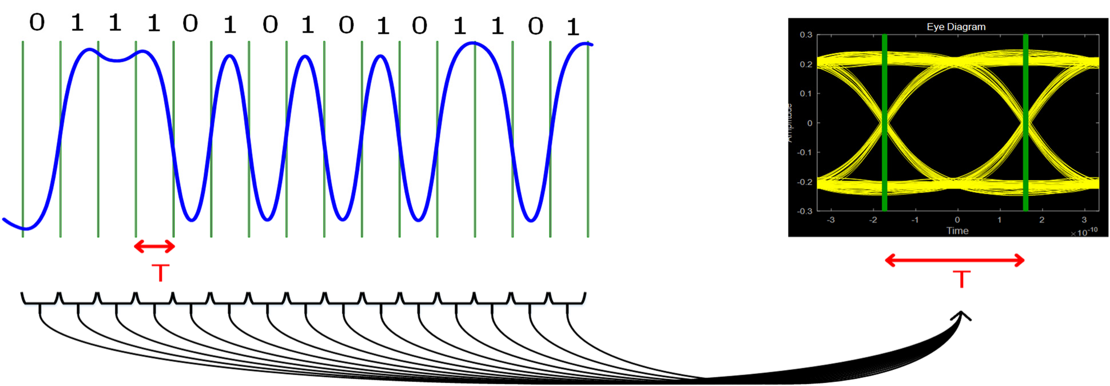
Eye Diagram (1)
1
Vth
0
noise margin
Checking whether ISI accumulation that may cause decision error
  With a complex bit pattern
Construction
  Cut a waveform with symbol period T (or its integer multiple)
  Overlay the sliced pieces of the waveform
Notes:
2️⃣ NRZ vs. PAM4 Eye Diagram Intuition
📦 Analogy: Packing Boxes in a Truck
Imagine you’re moving houses and need to pack a truck with boxes.
NRZ = One big box per trip.
Two levels: Box fits or doesn’t (0 or 1).
Fewer mistakes, simpler handling.
PAM4 = Two smaller boxes stacked in the same trip.
Four levels: Box could be empty, 1/3 full, 2/3 full, or full.
More efficient use of space (higher data rate), but requires more careful handling—if a box gets slightly crushed, it’s harder to tell how full it was.
👀 Eye Diagram = Road Visibility Test
If you’re driving at night, a wide-open road (NRZ eye diagram) means clear vision.
A cluttered, foggy road (PAM4 eye diagram) makes it harder to distinguish lane markings.
🟢 More eye openings = More opportunities for errors. That’s why PAM4 needs better receivers and equalization.
🔑 Final Takeaway:
✔ Higher speeds & longer channels cause loss → leading to ISI
✔ NRZ is simple but limited in bandwidth
✔ PAM4 packs more data but requires better handling
Would you like more depth on any of these? 🚀

Slide 21
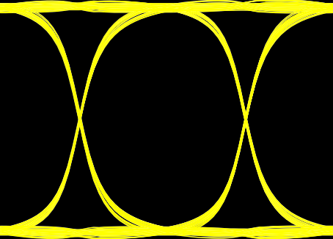
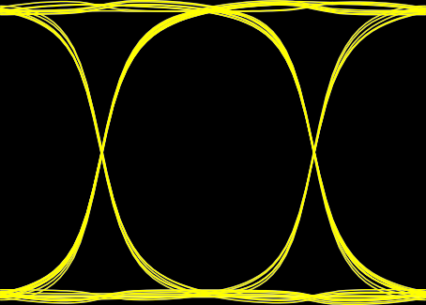
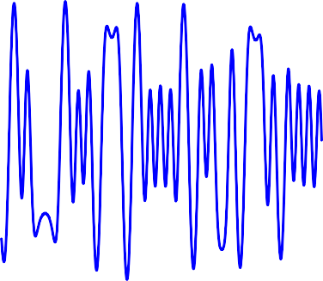
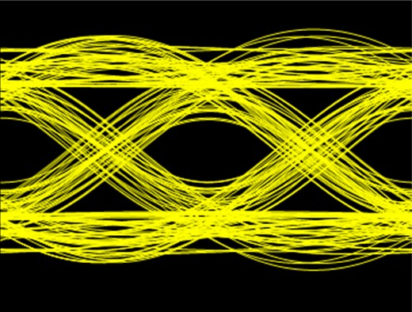
Eye Diagram (2)
Small ISI
Vth
noise margin
Large ISI
Vth
noise margin
□ ISI reduces the eye size.
Notes:
Eye Diagram & Inter-Symbol Interference (ISI)
What is an Eye Diagram?
An eye diagram is a visualization of a signal’s quality over multiple bit periods.
A wider and more open eye indicates better signal integrity.
Impact of ISI on Eye Diagram:
Small ISI (Upper Eye Diagram)
Minimal distortion from previous bits.
Larger noise margin → Better signal detection.
Large ISI (Lower Eye Diagram)
Strong inter-symbol interference distorts the waveform.
Smaller noise margin → Higher probability of bit errors.
Key Takeaway:
ISI reduces the eye opening, leading to degraded signal quality and higher BER (Bit Error Rate).
To mitigate ISI, techniques such as equalization, pulse shaping, and pre-emphasis are used.

Slide 22
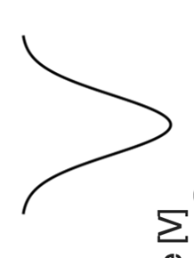
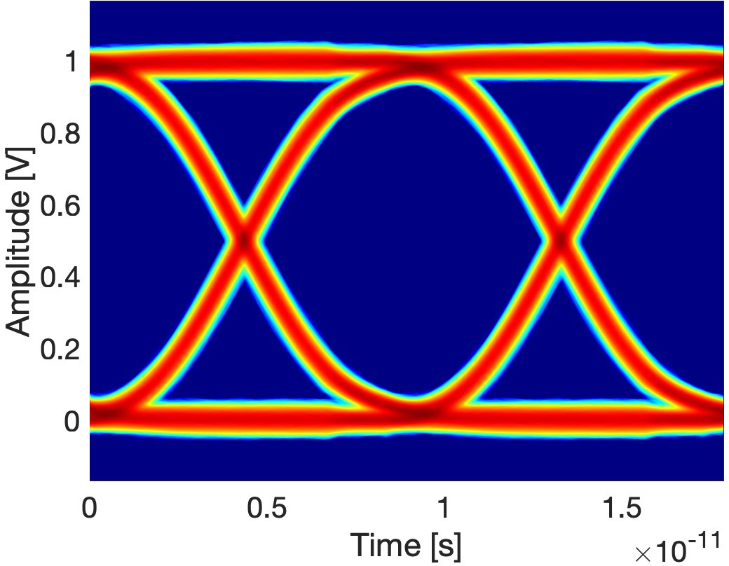
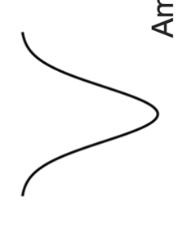
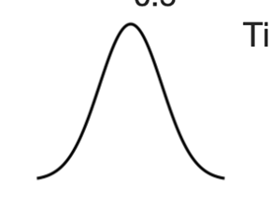
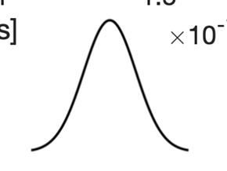
NRZ Eye Diagram Analysis
Probability distribution of noise
^{V}top
(µ_{top})
Vertical eye opening / height
Eye amplitude
^{𝝈}top
^{V}bot
(µ_{bot})
^{𝝈}bot
Horizontal eye opening / width
^{𝝈}cross1
^{𝝈}cross2
^{t}cross1
^{t}cross2
Eye height= (V_{top} – 3𝝈_{top}) – (V_{bot} + 3𝝈_{bot})
□
^{Eye width = (t}cross2 ^{– 3𝝈}cross2^{) – (t}cross1 ^{+ 3𝝈} cross1⁾

Slide 23
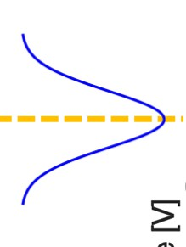
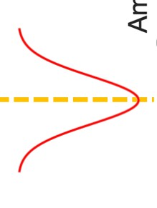
Bit Error Rate (BER)
t_{S}
^{t}j,pp
If the received bit is different from the transmitted → bit error
^{V}DTH
No. of bit errors
□
^{BER =} No. of transmitted bits
BER characterization: BER-tester or loop back
Mathematical model with a normalized threshold of V_{DTH}=0.5
■
This area is the probability that 0 is decoded as 1
This area is the probability that 1 is decoded as 0
Notes:
🔹 Intuition Behind BER (Bit Error Rate)
BER measures how often bits are received incorrectly due to noise, distortion, or signal degradation.
📬 Analogy: Delivering Messages in a Noisy Room
Imagine you are in a crowded, noisy room trying to communicate a message to a friend:
If the room is quiet, your friend hears you perfectly—zero errors.
If the room is noisy, your friend might mishear words, leading to errors.
In communication systems:
A "0" bit might be mistaken for a "1", or vice versa, due to noise in the channel.
More errors mean a higher BER → worse signal integrity.
📉 BER Formula:
BER=Number of Bit ErrorsTotal Transmitted BitsBER = \frac{\text{Number of Bit Errors}}{\text{Total Transmitted Bits}}BER=Total Transmitted BitsNumber of Bit Errors​Lower BER = Better signal quality
Higher BER = More corruption in data
🔹 Eye Diagram and BER
An Eye Diagram shows how clean or distorted a signal is:
A wide-open eye → Clear distinction between 1s and 0s → Low BER
A closed eye (distorted signal) → Hard to differentiate bits → High BER
In the eye diagram:
Red & blue areas show the probability of bit flipping.
Red = A "0" mistakenly read as "1".
Blue = A "1" mistakenly read as "0".
The threshold voltage VDTHV_{DTH}VDTH​ acts like a decision boundary:
If the signal is above VDTHV_{DTH}VDTH​ → Read as "1".
If the signal is below VDTHV_{DTH}VDTH​ → Read as "0".
Noise & jitter cause overlap → Errors increase.
🔹 🚦 Another Analogy: Traffic Light in Fog
A clear traffic light (open eye) → Drivers easily see red, yellow, or green.
A blurry or flickering light (closed eye) → Confusion leads to errors (misreading the signal).
💡 More distortion = More confusion = Higher BER!

Slide 24
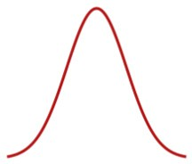
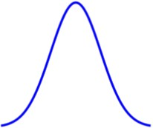
Bit Error Rate (BER) II
_{Φ} 𝑥 − 𝜇
𝜎
≡ 𝐶𝐷𝐹
Noise is assumed to be normal distributed [3]
  Mean free 𝜇 = 0 and variance 𝜎²
V
DTH
x/1V
0
∞
𝑝_{𝑒𝑟𝑟 0} 𝑥 ≥ 0.5 = ∫
0.5
0.5
1
₋ 0.5−0 ²
“BER” means the probability that noise becomes larger than the threshold V_{DTH}
𝑒
2σ²
𝑑𝑥
2𝜋𝜎²
_{= 1 − Φ} 0.5 − 0
_{= Φ −} 0.5
𝑝
𝑒𝑟𝑟 0
𝑥 ≥ 0.5
𝜎
𝜎
Probability of an error p(bit error) → BER
𝑝 bit error = 𝑝 TX = 0 · 𝑝_{𝑒𝑟𝑟 0} 𝑥 ≥ 0.5 + 𝑝 TX = 1 · 𝑝_{𝑒𝑟𝑟 1} 𝑥 ≤ 0.5
^{V}DTH
_{Φ −}0.5 _{Φ −}0.5
x/1V
𝑝 bit error = 0.5 ·
+ 0.5 ·
σ σ
0.5 1
𝑝_{𝑒𝑟𝑟 1} 𝑥 ≤ 0.5 = ∫
𝑝 bit error
_{= Φ −}0.5
0.5
1
₋ 0.5−1 ²
σ
𝑒
2σ²
𝑑𝑥
For low BER: maximize signal amplitude,
−∞
2𝜋𝜎²
0.5 − 1
0.5
minimize noise & jitter
^{𝑝}𝑒𝑟𝑟 1
𝑥 ≤ 0.5 = Φ
𝜎
= Φ −
𝜎

Slide 25
Bit Error Rate (BER) III
Vertical and horizontal BER
  BER depends on decision threshold V_{DTH} and sample instant t_{S}
BER BER
Horizontal ₍₁₎
Vertical eye margin
eye margin
(2)
0.5 0.5
0.5
Better
₁₀-12 ₁₀-12
t_{S}
VDTH
0
Bit period
Tbit
Vbot
Eye amplitude
Vtop
("1")
BiBitt ppeerriioodd
("0")
(1) Faster link speed → shorter bit period (T_{bit}) → higher BER
(2) Higher TX eye amplitude → improved SNR → lower BER

Slide 26
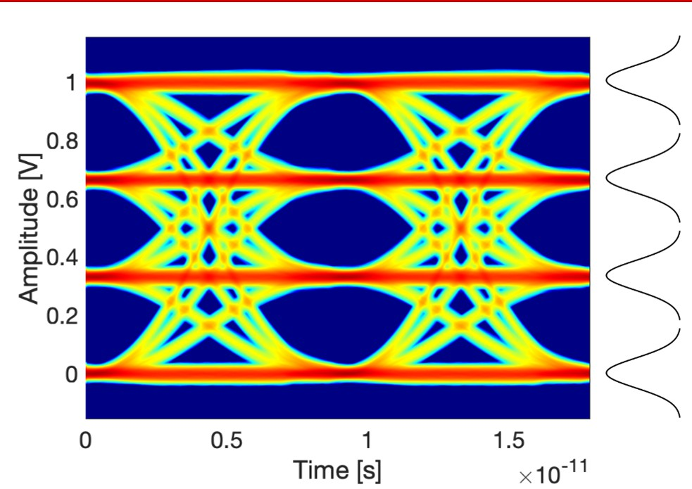
PAM4 Eye Linearity
V₃
V₂ V₁
𝑆_{MIN} = min 𝑉₃ − 𝑉₂, 𝑉₂ − 𝑉₁, 𝑉₁ − 𝑉₀
𝑅𝐿𝑀 = ^{3 ⋅ 𝑆MIN}
𝑉₃ − 𝑉₀
_{Eye linearity =} max(𝑉₁ − 𝑉₀, 𝑉₂ − 𝑉₁, 𝑉₃ − 𝑉₂)
V
0
min(𝑉₁ − 𝑉₀, 𝑉₂ − 𝑉₁, 𝑉₃ − 𝑉₂)
PAM4 eye linearity critical for low BER
Eye compression:
  Minimum signal level 𝑆_{𝑀𝐼𝑁} → swing between adjacent symbol levels
  Resulting relative level mismatch (𝑅𝐿𝑀)
Eye linearity: Compares maximum to minimum eye voltage level

Slide 27
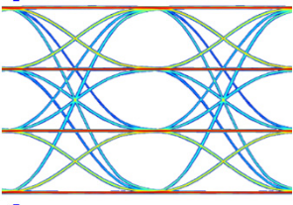
Basic Wireline Link - TX
TX
RX
R_{T}
Z_{L}
R_{T}
MUX
DEMUX
Eq.
Driver
Eq.
CDR
PLL
^{V}out,TX
PLL
TX serializes parallel data
TX drives channel with large (enough) voltage swing
TX amplitude critical for link SNR and BER
TX linearity critical for PAM4-based link SNR and BER

Slide 28
Role of Equalizers in Wireline/Optical Links
Notes:
Now lets see the assembled prototype

Slide 29







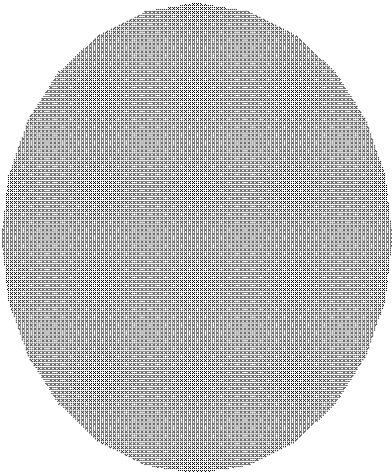

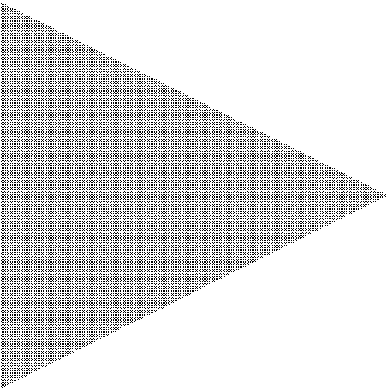

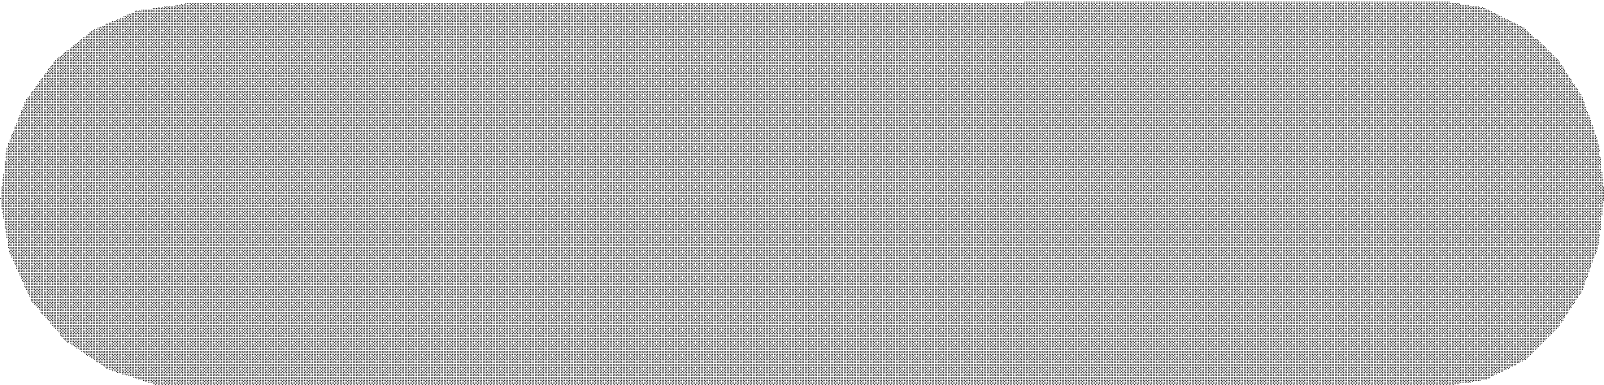








Channel Behaviors
DFE
Digital
Feedback
Digital
FFE
CTLE
+
PLL
Channel
PLL
CDR
Equalization techniques
  Continuous time linear equalizer (CTLE)
  Feed forward equalization (FFE)
  Decision feedback equalization (DFE)
Magnitude
Frequency

Slide 30


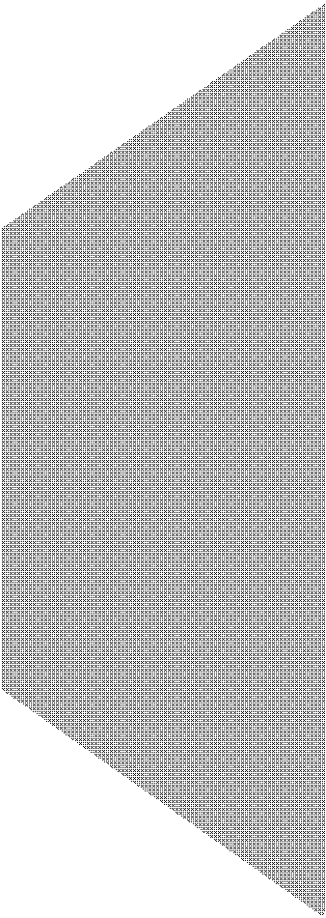


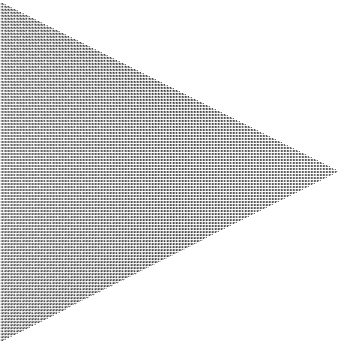

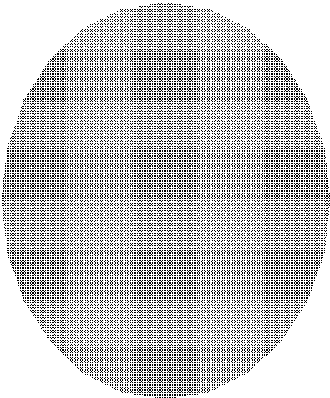








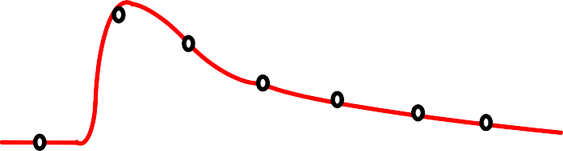
Equalization
Digital
Digital
PLL
Channel(LPF)
PLL
CDR
Inter symbol Interference (ISI)
Magnitude
_{S}-1
Frequency
Channel (LPF)
Single bit response (SBR)

Slide 31




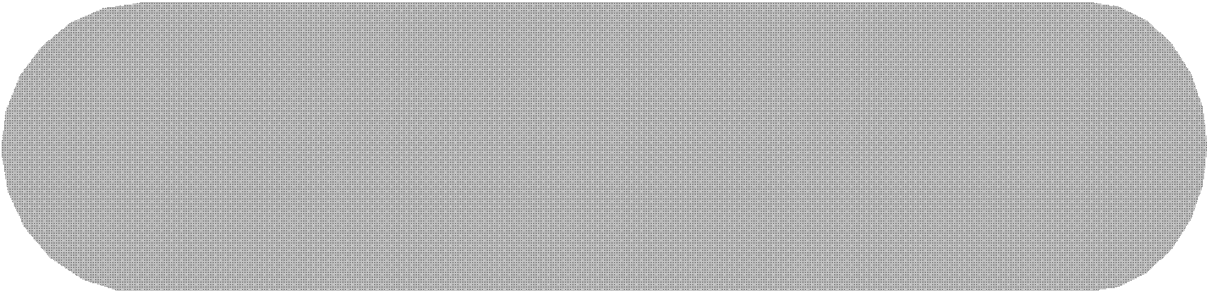


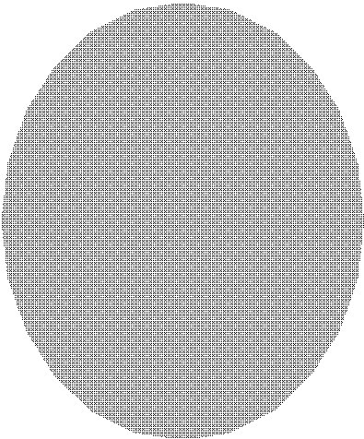







Continuous Time Linear Equalizer
Digital
Digital
CTLE
PLL
Channel(LPF)
PLL
CDR
Magnitude
Magnitude
Magnitude
_{S}-1
S
Frequency
Channel (LPF)
Frequency
CTLE (HPF)
Frequency
Overall Response (Flat)
Continuous time linear equalizer (CTLE)
  A high-pass filter (HPF) flattens the overall response in the band of interest.

Slide 32
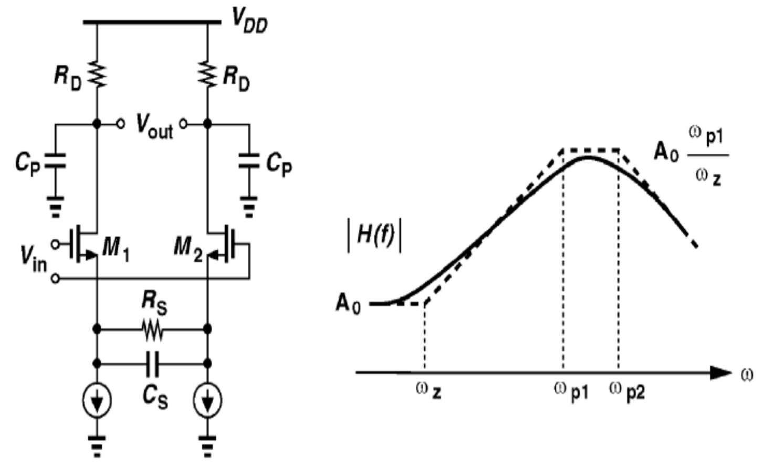
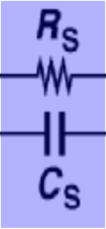
Active CTLE
□ Attenuates low-frequency gain by frequency-selective source degeneration
s +ω_{z}
H (s) = ^{gm}
C_{p} (s +ω_{p1} )(s +ω_{p2} )
× 1
1
R_{s}C_{s}
1
R_{D}C_{p}
1+0.5g_{m}R_{s}
ω_{z} =
1+ 0.5g R
ω_{p2} =
ω =
m s
p₁
RC
s s
High-frequency gain ≈ g_{m}R_{D}
[8] Gondi JSSC 2007
g_{m}R_{D}
Low-frequency gain ≈
1
1+ 0.5g_{m} R_{s}
×
Frequency-selective source degeneration
1+ 0.5g R
m s
Notes:
🔹 Intuition Behind Active CTLE (Continuous-Time Linear Equalizer)
A CTLE is used in high-speed receivers to compensate for channel losses by boosting high-frequency components while attenuating low-frequency components. This improves the signal quality before further amplification or detection.
📬 Analogy: Tuning a Radio for Clear Sound
Imagine you're listening to a radio station with both bass (low frequency) and treble (high frequency):
If there's too much bass, the sound feels muffled.
If there's too little bass, the sound feels thin and lacks depth.
The CTLE acts like a tone control, selectively reducing excess low frequencies while keeping the high frequencies intact.
🔹 How Does It Work?
The active CTLE uses frequency-selective source degeneration, achieved by adding a resistor (RSR_S) and capacitor (CSC_S) in series at the source of the transistor.
1️⃣ Low-Frequency Gain is Reduced
At low frequencies, CS is open-circuit, so RS provides degeneration, reducing the gain by a factor of 1+0.5gmRS1
Key takeaway: Low-frequency components are attenuated.
2️⃣ High-Frequency Gain is Maintained
At high frequencies, CS behaves like a short circuit, bypassing RS, effectively removing degeneration.
Key takeaway: High-frequency components remain strong.
3️⃣ Pole-Zero Behavior Shapes the Frequency Response
The system introduces a zero at ωz=1RSCS\omega_z = \frac{1}{R_S C_S}, boosting gain at higher frequencies.
A dominant pole at ωp1\omega_{p1} limits the gain beyond a certain frequency.
Overall effect: Boosting of high frequencies while suppressing low frequencies → equalization effect!
🔹 🚦 Another Analogy: Slope Adjustment on a Mountain Road
Imagine you're driving on a mountain road:
Flat areas (low frequencies) slow you down due to friction.
Steep slopes (high frequencies) help you accelerate.
The CTLE adjusts the road's slope so that low-speed areas (low frequencies) don’t dominate, keeping motion smooth.
💡 By suppressing low frequencies and maintaining high-frequency components, the CTLE ensures clearer signal transmission at high speeds!
Would you like a complete slide recreation similar to your existing format? 🚀

Slide 33






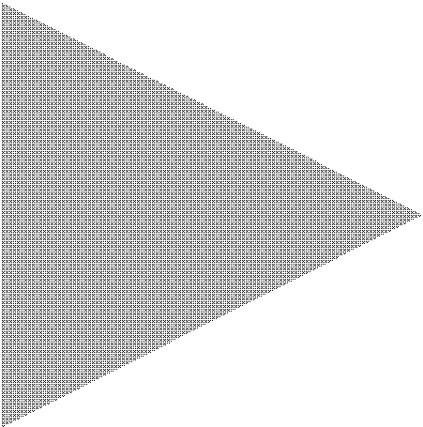

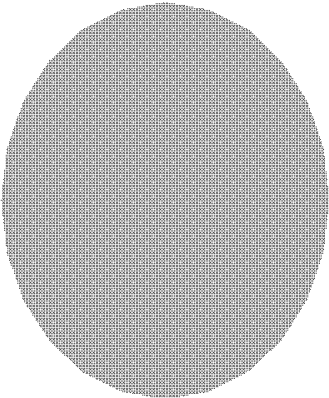







Feed Forward Equalization (1)
Digital
Digital
FFE
PLL
PLL
CDR
Magnitude
Magnitude
Magnitude
Frequency
FFE (HPF)
Frequency
Channel (LPF)
Frequency
Overall Response (flat)
Feed forward equalization (FFE)
  A high-pass filter (HPF) flattens the overall response in the band of interest.
Notes:
This slide explains Feed Forward Equalization (FFE) and its role in compensating channel loss. Here’s a breakdown:
Key Concepts
Feed Forward Equalization (FFE) Acts as a High-Pass Filter (HPF)
The blue graph shows that FFE boosts high-frequency components while suppressing low frequencies.
The Channel Acts as a Low-Pass Filter (LPF)
The red graph shows how the transmission medium attenuates high-frequency signals, leading to signal degradation.
Overall System Response Becomes Flat
The green graph shows that by applying FFE before transmission, the signal distortion caused by the LPF nature of the channel is mitigated, resulting in a relatively flat response.
Main Takeaways
FFE helps compensate for inter-symbol interference (ISI) by pre-emphasizing high-frequency content.
The combination of FFE (HPF) and the channel (LPF) results in a balanced response across the signal bandwidth.
This technique is widely used in high-speed serial links to improve signal integrity.
Would you like me to format this into a proper slide like the previous one? 😊
4o

Slide 34
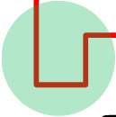

Feed Forward Equalization (2)
Without equalization ^{…0010000…}
Cancel ISI
Feed forward
…0010000…
equalization (FFE)
D
w0
+
D
w1
A finite impulse response (FIR) filter for pulse-shaping
Negative peaking cancels ISI
Notes:
Why Equalization is Needed?
Without equalization, high-speed signals suffer from Inter-Symbol Interference (ISI) due to channel impairments.
This leads to distorted eye diagrams and errors in data recovery.
Concept of Feed Forward Equalization (FFE)
FFE is a Finite Impulse Response (FIR) filter that pre-emphasizes the transmitted signal.
It works by adding a weighted sum of previous symbols to the current symbol.
How FFE Cancels ISI?
The filter applies negative peaking to counteract channel distortion.
The resulting signal is closer to the ideal pulse, reducing ISI and improving detection.
Key Takeaways
FFE improves data integrity by compensating for channel losses.
It is commonly used in wireline and optical links for high-speed data transmission.
Proper coefficient tuning is critical to achieving optimal performance.

Slide 35
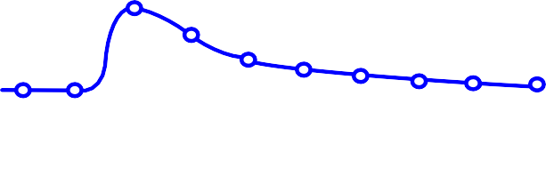

Feed Forward Equalization (3)
…0010000…
A 2-tap FFE example
D
w0
+
D
w1
Main tap (W₀)
+
+
Post-cursor
tap (W₁)
=
=
TX output
Notes:
Introduction to Multi-Tap FFE
The previous slide introduced the concept of feed-forward equalization (FFE) to combat ISI.
Here, we extend the idea by introducing a 2-tap FFE, which applies filtering over multiple past symbols.
Understanding the Diagram
The main tap (W₀) (blue) represents the current symbol contribution.
The post-cursor tap (W₁) (green) compensates for ISI caused by previous symbols.
The final transmitter output (red) is the sum of these weighted contributions.
How Does 2-Tap FFE Work?
Each symbol is delayed and weighted before summation.
The post-cursor tap applies a controlled negative peak to cancel the tail of the previous pulse.
This method improves pulse shaping, leading to a clearer eye diagram.
Key Takeaways
More taps = Better ISI cancellation, but higher complexity.
Tap weights (W₀, W₁, …) are optimized based on the channel response.
This approach is widely used in SerDes, optical, and wireline communications.

Slide 36
A 2-tap FFE TX Example
x_{i}=1 if D_{i}=1 x_{i}=-1 if D_{i}=0
x₀
0.6
^{V}FFE
x₁
D
-0 .4
^{V}FFE
= 0.6x₀ − 0.4 x₁
A shift register for a delayed data sequence (x₀ and x₁) with an interval of a bit period
Tap output: x_{i} multiplied by tap coefficient
FFE output: sum of all outputs of taps

Slide 37
Current Mode FFE (1)
x_{i}=1 if D_{i}=1 x_{i}=-1 if D_{i}=0
D₀
D₁
R
R
D₀D₁ = 11
D
<
x₀
+
0.6
-
^{V}FFE
D
D
D
D₁
0
0
1
x₁
D
-0 .4
0.6I
0.4I
^{V}FFE
= 0.6x₀ − 0.4 x₁
Also called current mode logic (CML) type FFE
Consists of a shift register, differential current switches, and pull-up resistors

Slide 38
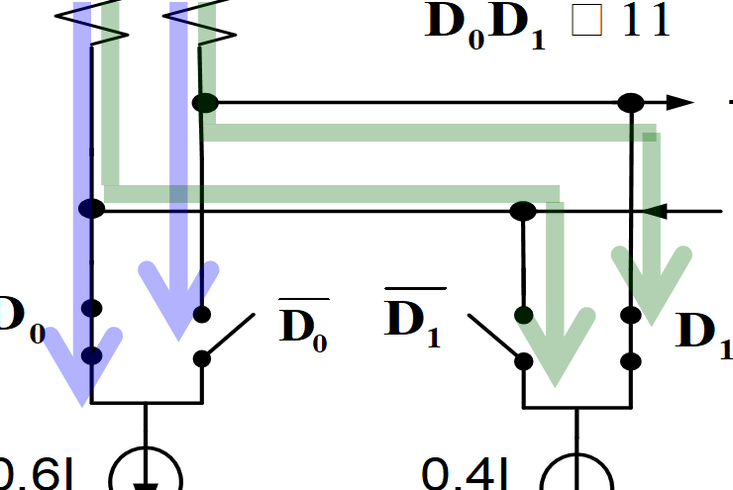
Current Mode FFE (2)
x_{i}=1 if D_{i}=1 x_{i}=-1 if D_{i}=0
D₀
D₁
R
R
=
D
D₀D₁ < 11
^{D}0 D0 ^{D}1 D₁
.6I 0.4I
x₀
+
0.6
-
^{V}FFE
I = 0.4Ix
I_{diff 0} = −0.6Ix₀
diff 1
1
x₁
D
-0 .4
0
^{V}FFE
= 0.6x₀ − 0.4 x₁
A shift register produces a delayed bit sequence (D₀ and D₁).
Differential current switches conduct the differential tap currents (-0.6Ix₀ and 0.4Ix₁), depending on data (x₀ and x₁).

Slide 39
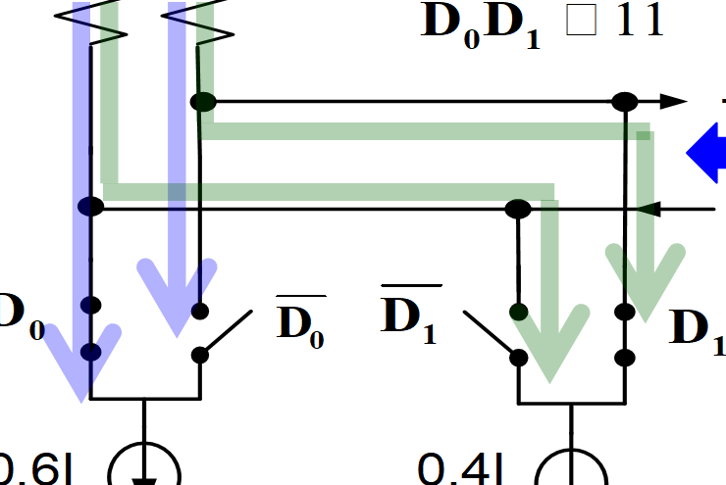
Current Mode FFE (3)
x_{i}=1 if D_{i}=1 x_{i}=-1 if D_{i}=0
D₀
D₁
R
R
=
D
D₀D₁ < 11
^{D}0 D0 ^{D}1 D₁
.6I 0.4I
x₀
+
R=50 Ω
0.6
-
^{V}FFE
I = 0.4Ix
I_{diff 0} = −0.6Ix₀
diff 1
1
x₁
D
-0 .4
0
= −RI_{diff} = 0.6RIx₀ −0.4RIx₁
^{V}FFE
= 0.6x₀ − 0.4 x₁
^{V}diff
Differential voltage is proportional to sum of differential tap currents
  Widely used for differential signaling
Resistance = 50 Ω for impedance matching

Slide 40


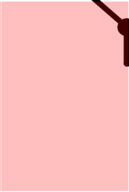


Coefficient Control
R
R
D D = 11
0 1
<
D
D₁
R
R
D D = 11
+
0
D
0 1
<
+
-
X
-
X
X
X
D₀
D₀
0
D₁
D₁
0
1
1
D₀
D₀
D₁
D₁
Sgn0
D₀
Sgn1
D₁
0.6I
0.4I
Sgn0
D₀
Sgn1
D₁
0.6I
0.4I
0.6I 0.4I
FFE coefficient control
  Magnitude: current DACs
  Polarity: exclusive-or gates

Slide 41
Optical Transceiver Basics
Notes:
Now lets see the assembled prototype

Slide 42

Optical Fiber
©Alcatel-Lucent
Optical fiber, unlike Cu, has lower loss ~0.2-0.4dB/km and lower frequency-dependence
Optical signal within fiber and waveguides less susceptible to crosstalk
Supports multiple data streams, each on a separate wavelength, on the same waveguide or fiber (WDM)
Easy cable management
Notes:
Optical Fiber – The Superhighway of Data! 🚀
Imagine a high-speed highway where cars (data) travel at light speed with minimal traffic jams (signal loss). That’s what optical fiber does for communication networks! 🌍✨
Why Optical Fiber is Awesome?
📌 Lower Loss, Longer Reach: Unlike copper (Cu) wires, which lose energy like heat in a rusty water pipe, fiber only loses ~0.2-0.4 dB/km—allowing data to travel miles without much weakening!
📌 Less Crosstalk, More Clarity: Think of copper as a crowded street with honking cars (electromagnetic interference), while fiber is a silent, underground bullet train—no noise, just smooth transmission! 🚆
📌 Wavelength Division Multiplexing (WDM) – The Multi-Lane Highway!
In fiber, multiple colors (wavelengths) of light carry different data streams simultaneously—just like having separate lanes for different types of vehicles! 🚗🚛🚲
📌 Flexible and Easy to Manage: Optical fiber is thin and lightweight—imagine rolling up a super-strong fishing line instead of dealing with heavy copper cables! 🎣
💡 Bottom Line: Optical fiber is the ultimate fast, efficient, and scalable solution for modern communication, from data centers to undersea cables! 🌊🔗

Slide 43






An Electro-Optical Link
E/O TX
O/E RX
Electrical I/O
Laser
Electrical I/O
CTRL
Isolator
Mod. PD
Fiber Optics
Pre-
Driver
TIA Amp/ Buffer
Driver
E/O TX O/E RX
Laser Isolator
I/O: Input/Output Mod.: Modulator PD: Photodetector
E/O: Electrical-to-Optical CTRL: Controller
O/E: Optical-to-Electrical
TIA: Transimpedance Amplifier
Amp: Limiting Amplifier/Main Amplifier
Coupler/Connector

Slide 44
Targeted Co-packaged Optical RX Front-end Architecture
Supports high integration
Low parasitics
r
e
b
i
CMOS IC
F
RX
TIA
BUF
on-pa
ckage
probing
PD
T
race with optimized Z
0
Packa
ge Subs
trate
PCB
Notes:
Taking this as motivation, We target our Optical receiver solution with Proposed TIA in CMOS with package substrate housing both the commercially available photodetector, the PD and the CMOS chip flip attached with optimized interconnect between them for best performance. Overall, this co-packaged flip-chip architecture can support high-integration while posing low parasitics. And of course, this heterogeneous integration offers flexibility of choosing best suitable technology for both CMOS and PD to achieve superior performance.

Slide 45
PD to RX Interconnect Optimization
Criticality of Optical Receiver Design
Notes:
Now we will dive into one of the key features of this work of optimizing the PD-to-RX interconnect.

Slide 46

PD to RX Interconnect Optimization Opportunity
Utilizing inductive property of the interconnect for series peaking
Achieved by appropriate selection of characteristics impedance, Z₀
$$Z_{0}=\sqrt{\frac{L′}{C′}}$$
Series peaking opportunity
Notes:
PD-to-RX interconnect being in the high-speed signal path, its design impacts the overall TIA BW. In this flip-chip co-packaged architecture, this interconnect is fabricated on the package substrate as a micro-strip structure.
We first, recognize the opportunity of utilizing the inductive property of this PD-to-RX interconnect for the series peaking to extend the BW. This can be observed by simply seeing the interconnect as an ideal transmission line and for simplicity whose characteristics impedance can be written as square root of inductance over capacitance per unit length. By simply reducing the interconnect width or in other words, increasing its characteristics impedance, we can give rise to its inductance and lower its capacitance. Having right amount of inductance between two relatively large capacitive elements which are the PD output and RX IC input can help reduce effective capacitance seen by the TIA in RX chip and extend the passive front-end BW. We optimize the PD-to-RX interconnect’s characteristics impedance for a given length to maximize the BW.

Slide 47
PD to RX Interconnect Optimization Passive Modelling
Notes:
To perform more accurate PD-to-RX interconnect optimization, we derive the necessary passive test bench model. We first extract the input impedance model of our proposed TIA which we will see in a bit, with 1-st order RC components. We also insert the ESD diode worth of 80 fF at the input for increased reliability and protection and extract the RX input bump pad capacitance of 100 fF. To reduce the effective capacitance imposed by ESD and bump pad, we include the series multi-layer multi-turn 20umx20um compact t-coil between them where it helps increase the BW by 2x.
For this PD-to-RX interconnect we extract the s-parameters from the layout using ADS tool. Lastly, we include the PD model provided by the vendor and LC based bump model to complete the overall front-end passive test bench. With the PD-to-RX interconnect under the spotlight of the optimization, we sweep the characteristics impedance for a fixed length and observe the transfer characteristics from the optical input in dBm to the resulting voltage at the TIA input. Nevertheless, the TIA input impedance model and selected T-coil depends on the TIA design, therefore the overall co-design may entail iterative optimization.

Slide 48
PD to RX Interconnect Optimization Simulations
60 GHz
60 GHz
For L = 250 µm, Z₀ = 80 Ω* is selected
For L = 500 µm, Z₀ = 50 Ω is selected
*Due to manufacturing limitations,
Z₀ = 75 Ω was fabricated.
Approx. 60 GHz of passive front-end BW is achieved with optimized interconnect
Notes:
We perform these simulations for two different interconnect lengths: 250 µm and 500 µm and these are the simulation results. The optimum characteristics impedance of a given interconnect length is selected by the one that provides flattest possible DC gain with highest BW.
We would first like to highlight the simulation with interconnect with length 0 µm (that is 0 distance between PD and RX which results in lowest BW as there is no inductive component between the PD capacitance and RX pad capacitance.
For 250um interconnect length, characteristics impedance of 80 Ω provided maximum BW. However, due to manufacturing limitations, 75 Ω was fabricated, instead. On the other side for the 500 µm length, characteristics impedance of 50 Ω achieved the max BW. In both cases, BW from optical input to the TIA input was extended at or beyond 60 GHz. We will later showcase the measurement results from the fabricated prototypes considering these two different interconnect lengths.

Slide 49
Inverter-Based Design for Bandwidth & Gain
Notes:
Now we explore our proposed TIA design.

Slide 50


Design Choice: Inverter-Based Stages
Low-voltage operation
  Higher linear swing for a given supply
Power efficient analog amplifier
  2x g_{m} for the same drain current
Compatible with Cherry-Hooper style high-BW broadband amplification
Self-biases to mid-rail with shunt-feedback
No internal parasitic poles
Ease of design and layout iterations
Scales well with technology
Sensitive to PVT: can be minimized by the LDOs [Lakshmikumar, JSSC’19]
Notes:
We will go thorugh some design choices we made for our TIA. We first select the inverter as a foundational block for the TIA chain as it offers low-voltage operation with higher linear swing, it is power efficient amplifier giving 2gm for the same drain current, is compatible with cherryhopper style high-BW amplification. Shunt-feedback self-biases inverters which are supported by the advanced technology with nmos and pmos having matched drive strength biasing them at mid-rail. They have no internal parasitic poles, and offers easy design and layout iterations and it scales well with technology also. Nevertheless, they are sensitive to PVT but its impact can be minimized by the use of LDO regulators.

Slide 51
Design Choice: Inverter-Based CTLE Architecture
Conventional CML-based CTLE
  Needs higher supply to operate
  Performance does not scale well with technology
  Non-ideal tail-current sources limits
  high-frequency operation
Inverter-based CTLE (This work):
  Low-voltage operation
  Cherry-Hooper style
  Passive CR high-pass filter for peaking
Low-freq Path
High-freq Path
[Razavi, John Wiley & Sons’12]
|V_{OUT}/V_{IN}|
f
Notes:
To achieve high-BW we require programmable CTLE in the TIA chain. The conventional CML CTLE needs higher supply to operate in linear region, and its performance does not scale well with process and non-ideal tail current limiting its high-frequency operation. we choose the following Inverter-Based cherry-hooper style CTLE. It has low-freq path for DC gain, and CR high-pass filtered path for high-freq gain. The TIS stage converts the previous transconductor stages’ current back to volage.

Slide 52
Design Choice: Low-BW First Stage Followed by CTLEs
High-BW & Low-noise TIA achieved by:
  Low-BW high-gain first stage
  Lowers R_{f} input-ref. thermal noise
  Targeted BW is recovered by CTLE
  CTLE input-ref. noise suppressed
  by the 1st stage gain
[Li, JSSC 2014]
[López, JSSC 2018]
Notes:
To achieve high-BW low-noise TIA, we follow similar approach as multiple previous work with our proposed CTLE. Here we have Low-BW shunt-feedback as 1st stage followed by the CTLE. This is achieved by having Low-BW high-gain first TIS stage followed by the CTLE. The high-gain in the first stage by having higher feedback resistor lowers its input referred thermal noise. The targeted BW is then recovered by the CTLE where CTLE input-ref. noise is suppressed by the high gain of the 1st stage, lowering the overall input referred noise while achieving desired BW.

Slide 53
Proposed TIA Overview
Notes:
Here is the overview of the our of proposed inverter-based TIA.
It consists of three stages operating at 0.9 V supply. First stage is a BW limited shunt-feedback inverter stage, second stage is inverter-based CTLE and third stage has another CTLE in parallel with VGA. we have inverter based LPF in feedback to subtract DC current from PD. We provide on-chip RC filter for PD bias which helps decouple PD bias noise to the chip ground.
For measurement purpose, we have linear CML buffers followed by required T-coil and ESD diodes to drive 50Ω load of the test equipment.
🔍 Proposed TIA Architecture: Breaking Down the Design
A low-power, high-bandwidth Transimpedance Amplifier (TIA) is critical for next-gen optical receivers, especially at 112G/224G PAM-4 speeds. This design leverages a three-stage architecture with embedded equalization to optimize performance.
📡 Key Building Blocks
✔ Photodiode (PD) & Input Matching
The PD converts optical power into a current signal (i_PD).
Proper impedance matching (L, Z₀) ensures signal integrity.
✔ TIA Stage 1: Front-End Amplification (TIS1)
Low-noise design to maximize SNR.
DC Offset Correction (DCOC) Loop prevents baseline wander.
Received Signal Strength Indicator (RSSI) for power monitoring.
✔ TIA Stage 2: Equalization & Gain Control (TIS2 + CTLE1)
Continuous-Time Linear Equalizer (CTLE1) compensates for high-frequency losses.
Second-stage gain boost for better eye opening.
✔ TIA Stage 3: VGA & Final Stage (TIS3 + CTLE2 + VGA)
Variable Gain Amplifier (VGA) for adaptive gain control.
Inductive peaking for bandwidth enhancement.
✔ CML Buffer & Output Stage
Converts signals to high-speed CML (Current Mode Logic) outputs.
1.2V Output Swing ensures compatibility with SerDes input stages.
⚡ Why This TIA?
✔ Low-Voltage (0.9V) CMOS Design: Power-efficient for high-speed applications.
✔ Embedded Equalization: CTLE stages compensate for fiber/channel loss.
✔ Inductor Peaking & VGA Control: Optimized for high-bandwidth and adaptive gain.
✔ Robust ESD Protection: Ensures reliability in real-world deployment.
This architecture ensures high sensitivity, wide bandwidth, and low power consumption, making it ideal for next-generation 112G/224G optical links. 🚀

Slide 54
Proposed TIA Schematic – Stage 1
1st stage with
10 GHz
BW
Notes:
Going into further detail of the TIA schematic:
We design our first shunt-feedback inverter stage with 10 GHz BW (which is roughly 1/3 of the overall BW) to allow maximum possible value for feedback resistor to maximize DC gain and lower the thermal noise contribution as discussed before.

Slide 55
Proposed TIA Schematic – Stage 2
4 dB boost at 25 GHz
Notes:
Our second stage, which is a cherry-hooper style, inverter-based CTLE stage which helps restore the targeted BW. Peaking frequency is adjusted by these tunable resistors. NMOS and PMOS transistors of CTLE are biased separated with diode-connected inverter for more programmability which also helps tune-out any ringing in the frequency response arising from process variation or packaging related parasitics. And this Transimpedance stage converts the transconductors output current back to voltage. Second stage is capable of providing maximum of 4 dB boost at 25 GHz.

Slide 56
Proposed TIA Schematic – Stage 3
7 dB boost
at 30 GHz
Notes:
The 3rd stage comprises a programmable inverter-based VGA, with another CTLE similar to the 2nd stage in parallel for further equalization. Last portion of 3rd stage has a large TIS with L1 in series and L2 in shunt-feedback providing further BW extension. Overall, this 3rd stage provides ~7 dB boost at 30 GHz.

Slide 57
Proposed TIA Schematic – Stage 3 S2D
15% swing boost
S2D
Notes:
Going back to the 3rd stage, the output node DN and input node DP of the final TIS stage forms TIA’s psueudo-differential output. Compare, to single-ended TIA output, this pseudo differential conversion provides swing boost of 15%. Differing Single-ended to differential conversion at the end allows for lower power and lower noise TIA.

Slide 58
TIA Transfer Characteristics Post-Layout Simulations
Includes PD model, optimized PD-to-RX interconnect, CML buffers and 50 Ω loads
Notes:
This is the post-layout simulations of TIA which includes the PD model, optimized interconnect, CML buffers and 50 Ω load. Here we can see stage 1 giving low bandwidth of 10 GHz with Stages 2 and 3 combined together, helps restore the BW.

Slide 59

Invertor Based TIA: Prior Art
[Public]
To
Buffer
Rx
Pad
M. Rakowski et al., ISSCC, 2015.
Popular TIA architecture for modern scaled technologies
Large number of stages required to meet gain and bandwidth
  Power consumption can be high
  DC variation at each stage increases with number of stages
  Power supply rejection also suffers as number of stages increase
Notes:
Inverter-Based TIA: Key Insights
Why Inverter-Based TIAs?
Popular choice for high-speed optical receivers in advanced technology nodes.
Utilizes CMOS inverters for amplification, enabling high gain and bandwidth.
Challenges of Multi-Stage Inverter-Based TIAs:
Increased Power Consumption → More stages lead to higher static and dynamic power.
DC Variation Across Stages → Accumulated offsets impact performance.
Degraded Power Supply Rejection → Higher susceptibility to supply noise with more stages.
Key Trade-offs:
Gain vs. Bandwidth: More stages enhance gain but can limit bandwidth.
Power vs. Noise: High-speed operation demands careful power optimization.
Takeaway:
While inverter-based TIAs are well-suited for scaled technologies, designing for optimal gain, bandwidth, and power efficiency requires careful stage balancing and compensation techniques.

Slide 60
Proposed TIA
[Public]
1.2V
Regulator
0.9V
20µm x 20µm
25µm x 25µm
Vout
Rx Bump
T-coils help achieve the required gain (1.5K) and bandwidth (>30GHz) in 3
stages
Less invertor stages reduces power consumption
Regulated supply is used for power supply noise reduction
Distribution Statement A –Approved for Public Release, Distribution Unlimited
Notes:
Intuitive Breakdown of the Proposed TIA
Designing a high-speed TIA (Transimpedance Amplifier) is like crafting a highway system for electrical signals—where gain is like amplifying road signs, bandwidth is keeping traffic moving, and power efficiency is fuel economy. Let’s break down how this proposed TIA achieves high gain, wide bandwidth, and low power consumption using clever design choices.
🚀 T-Coils: Boosting Speed Without Traffic Jams
Analogy: Think of T-coils as flyovers in a highway—they allow signals (cars) to pass smoothly without bunching up at bottlenecks.
How They Help: Inductors cancel some of the parasitic capacitance, allowing faster signal transitions and extending bandwidth beyond 30 GHz without excessive power.
Result: A high-speed, low-loss path for signals.
💡 Fewer Inverter Stages = More Efficient Design
Analogy: Imagine a relay race—the fewer handovers (stages), the faster and more efficient the race.
Traditional inverter-based TIAs need many stages to achieve high gain.
This design uses just three stages, thanks to T-coils enhancing gain and better device sizing (20μm × 20μm, 25μm × 25μm).
Result: Lower power consumption without sacrificing performance.
🔋 Regulated Supply = Smooth Power, No Noise
Analogy: If an entire city ran directly on an unstable power grid, lights would flicker and appliances would fail. A power stabilizer (regulator) ensures steady voltage delivery.
Why it Matters: Inverter-based TIAs suffer from power supply noise (TIS issue), causing gain fluctuations.
Solution: A regulated 0.9V supply isolates the TIA from 1.2V supply variations, improving noise rejection and ensuring consistent performance.
Result: Reliable signal amplification with reduced jitter and interference.
✨ Key Takeaways
✔ T-coils extend bandwidth by reducing capacitance effects.
✔ Fewer inverter stages improve power efficiency.
✔ Regulated supply reduces noise and gain variations.
This design optimizes the balance between speed, gain, and power, making it ideal for next-gen optical receivers at 112G NRZ and 224G PAM-4 speeds. 🚀🔬

Slide 61











TIA Architecture
[Public]
8X
<4>
<4>
4X
4X
<3>
<2>
<1>
 | <0>
<3>
2X
80
70
60
50
40 Zt 4k-6K
30
20
2X
<2>
1X
1X
<1>
1X
Zt (dBΩ)
5b
5b
<0>
1X
R3
R1
Photo Diode
0.9A/W
BW > 35 GHz
0.12-1kΩ
0.2-1.5kΩ
Integ. Noise <3 µA
Voutb
Rx µ Bump
25fF
PD
Parasitic 10fF
10
gm3
gm gm
E S D
InFo
⁰ 10⁵ 10⁶ 10⁷ 10⁸ 10⁹
Frequency (Hz)
₁₀10 ₁₀11
2
1
Parasitic 25fF
Single ended inverter-based TIA to utilize gm/C scaling
T-coil peaking to reduce number of stages and save power
Programmable NMOS-based resistor to control gain/BW
Distribution Statement A –Approved for Public Release, Distribution Unlimited
Notes:
🚀 Intuitive Breakdown of the TIA Architecture
Designing a high-speed TIA (Transimpedance Amplifier) is like tuning a high-performance sports car—you need speed (bandwidth), power efficiency, and control (gain tuning) to achieve smooth, noise-free performance. This architecture achieves all three with smart circuit tricks.
💡 Single-Ended Inverter-Based TIA: Faster & More Efficient
Analogy: Think of an inverter-based TIA as a lightweight sports car—it’s fast, efficient, and doesn’t carry extra bulk.
Traditional TIAs rely on differential pairs, which consume more power.
This single-ended inverter-based design leverages gm/C scaling, meaning the gain-bandwidth product improves naturally as transistor size scales.
Result: Higher bandwidth (>35 GHz) with lower power consumption.
🔄 T-Coil Peaking: Keeping the Signal Sharp
Analogy: Imagine a suspension system in a car—T-coils act like shock absorbers, preventing excessive delay and signal distortion.
At high frequencies, circuit parasitics slow down the response.
T-coils counteract parasitic capacitance, ensuring smooth, high-speed signal transmission.
Result: Fewer amplifier stages, lower power, and better performance.
🎚️ Programmable NMOS-Based Resistor: Adaptive Control
Analogy: This is like an adjustable suspension system in a race car—you can fine-tune the ride based on road conditions.
A programmable NMOS-based resistor controls gain and bandwidth dynamically.
Resistor tuning (from 0.2 kΩ to 1.5 kΩ) adjusts the feedback network, optimizing TIA performance.
Result: Flexible design that adapts to different data rates and optical input conditions.
📊 Performance Highlights
✔ High transimpedance gain (4kΩ - 6kΩ) ensures strong signal amplification.
✔ Bandwidth >35 GHz means it can handle ultra-high-speed optical data.
✔ Integrated noise <3 µA, ensuring a clean, low-noise signal.
This TIA is a perfect balance of speed, efficiency, and adaptability, making it ideal for next-generation 112G NRZ and 224G PAM-4 optical receivers. 🚀📡

Slide 62
TIA: Low Noise Design
[Public]
𝟐
1.2V
_{𝒊}𝟐
𝟐
𝟏
𝑪 𝝎
≈ 𝒊^{𝟐} × 𝒁 (𝝎) ×
𝒏 𝒈𝒎 𝒕_𝒔𝒄𝒂𝒍𝒆𝒅
×
𝒊𝒏
Regulator
𝒏 𝒊𝒏
(𝒈 𝑹 )^{𝟐}
𝒈
𝒎 𝒇
𝒎
0.9V
M. Raj et al., JSSC 2020
Vout
Rx Bump
Cin
First invertor is the main noise source due to peaking from C_{in}
Reduce C_{in} as much as possible—waveguide-based PD, no Power Grid (PG) under bump
Increase g_{m} until it does not increase C_{in}
Reduce parasitic and gate resistance in the Ipd path – use low fin mos
Distribution Statement A –Approved for Public Release, Distribution Unlimited
Notes:
🎯 TIA Low-Noise Design: Breaking It Down Intuitively
Designing a low-noise TIA is like fine-tuning a high-sensitivity microphone—you want to capture the signal without amplifying unwanted noise. Here’s how this architecture tackles noise and ensures clean signal amplification.
🔊 First Inverter: The Main Noise Culprit
Analogy: Imagine you're using a microphone near a noisy speaker—it amplifies both the voice and unwanted feedback.
The first inverter stage dominates the noise due to peaking from Cin (input capacitance).
The noise current is proportional to (Cin ω / gm)², meaning larger Cin = higher noise.
Solution: Reduce Cin and increase gm carefully.
🛠️ Reducing Cin: Minimizing Unwanted Capacitance
Analogy: Think of Cin as extra baggage on a high-speed train—it slows things down and increases energy waste.
Waveguide-based photodiodes help minimize Cin.
No Power Grid (PG) under the bump reduces parasitic capacitance.
Result: Lower input-referred noise, better TIA performance.
📈 Boosting gm Without Increasing Cin
Analogy: Increasing gm is like improving an engine’s power, but if you add too much weight (Cin), you lose efficiency.
Increasing gm (transconductance) helps reduce noise.
However, beyond a point, higher gm increases Cin, leading to diminishing returns.
Optimal balance is needed between gm and Cin.
⚡ Parasitic & Gate Resistance Reduction: Keeping It Clean
Analogy: Think of gate resistance as friction in a mechanical system—too much, and you lose efficiency.
Parasitics in the photodiode path add unnecessary noise.
Using low-Fin MOSFETs reduces gate resistance, improving noise performance.
Result: Cleaner, low-noise amplification at high speeds.
📊 Key Takeaways
✔ Lower Cin = Lower Noise—optimized layout and waveguide-based PDs help.
✔ Smart gm scaling—boost gm only until noise improves without increasing Cin.
✔ Low-Fin MOSFETs reduce resistance and parasitic noise.
This low-noise TIA architecture is optimized for high-speed optical receivers, ensuring high sensitivity, low noise, and robust performance for 112G/224G applications. 🚀🔬

Slide 63










Overall RX Architecture
[Public]
5b
5b
R3
R1
Photo Diode
0.9A/W
Deser.
4 +1
0.12-1kΩ
0.2-1.5kΩ
Voutb
Rx µ Bump
PD
Parasitic
10fF
gm3
gm gm
E S D
InFo
PRBS Checker
2
1
25fF Parasitic
25fF
12.5GHz ₄
2b res
40-80Ω
21kΩ
Low Pass
Cancel
Average
Clk
-
3b
0-1.3mA
range
64 +16
1.2V
Reg
0.88V
TIA
21kΩ
4b p
+
OTA
PD Current
Vcm
Improves differential
To
CDR
4b n
PSRR
Common Mode Gen.
Voutb is directly fed to the four data and one error slicers
Kickback matched on the Vcm and Voutb node
Distribution Statement A –Approved for Public Release, Distribution Unlimited
Notes:
📡 High-Speed RX Architecture: Breaking It Down
A high-speed optical receiver is like a precision radar system—it needs to capture weak signals, filter out noise, and deliver clean data to the next stage. Let’s break down how this RX architecture achieves that.
🔍 The Front-End: Detecting & Amplifying the Signal
Analogy: Think of a photo diode (PD) as a telescope lens—it collects incoming light and converts it into an electrical signal.
The photo diode generates a current (~0.9 A/W) proportional to the received light.
Parasitic capacitance (25fF + 10fF) adds unwanted noise, so careful layout is critical.
The TIA (Transimpedance Amplifier) converts the weak current into a voltage signal.
✔ Key Focus: Minimize PD parasitics and optimize TIA bandwidth for high-speed performance.
🔊 Noise & Common-Mode Handling
Analogy: Imagine balancing a seesaw—you need to maintain symmetry to keep it stable.
gm stages (gm1, gm2, gm3) provide voltage gain while keeping noise low.
Common-mode generator ensures a stable voltage reference (Vcm).
OTA-based feedback cancels average PD current, improving PSRR (Power Supply Rejection Ratio).
✔ Key Focus: Reduce kickback noise and ensure matched common-mode rejection for cleaner signals.
📡 High-Speed Clocking & Data Processing
Analogy: Think of this as a highway with multiple lanes—data moves in parallel to maintain speed.
125 GHz clock ensures rapid sampling.
Deserializers split data (64+16) into smaller chunks for processing.
Four data slicers + error slicer recover the original high-speed data.
✔ Key Focus: Optimize clocking and slicers to minimize jitter and maximize data integrity.
🔑 Key Takeaways
✔ Minimize PD parasitics for better bandwidth.
✔ Optimize gain stages (gm1–gm3) to balance noise and speed.
✔ Common-mode control improves PSRR and noise immunity.
✔ High-speed deserialization and CDR ensure accurate data recovery.
This RX architecture is designed for ultra-high-speed optical communications (112G/224G+), ensuring reliable signal detection, amplification, and data extraction. 🚀🔬

Slide 64
Why no DFE ?
[Public]
There is a BW. vs. noise trade-off in the Rx
Traditionally a low BW. TIA and DFE is used to break this trade-off
But DFE is power hungry and costly to implement at high-speeds
Over-peaking at Tx can allow the Rx to reduce its BW. without compromising on Tx modulation amplitude
_{𝒊}𝟐
𝟐
𝟏
𝑪_{𝒊𝒏}𝝎
𝟐
≈ 𝒊^{𝟐} × 𝒁
(𝝎) ×
×
𝒏 𝒊𝒏
𝒏 𝒈𝒎
𝒕_𝒔𝒄𝒂𝒍𝒆𝒅
(𝒈 𝑹 )^{𝟐}
𝒈
𝒎 𝒇
𝒎
Noise
TIA Bandwidth
Rx Eye
Over-peaked Tx
Noise
Conventional Tx
TIA Bandwidth
Rx Eye
52 of 72
Notes:
🚀 Why Skip DFE in High-Speed RX Design?
High-speed receivers often face a bandwidth vs. noise trade-off. Traditionally, a low-bandwidth TIA and DFE (Decision Feedback Equalizer) help break this trade-off. However, at extreme speeds, DFE becomes power-hungry and costly to implement.
📉 The Problem with DFE at High Speeds
✔ DFE increases power consumption significantly.
✔ DFE complexity grows non-linearly with speed, making it impractical for 224G systems.
✔ DFE requires precise adaptation, which is challenging in process variations.
🛠 The Alternative: Leveraging TX Over-Peaking
Instead of relying on DFE, a smart approach is to apply controlled over-peaking at the transmitter:
Over-peaked TX compensates for RX bandwidth limitations.
This allows the RX to operate with a lower bandwidth, reducing noise without sacrificing modulation amplitude.
Result: A cleaner, wider RX eye opening with lower power consumption.
🔑 Key Takeaways
✔ DFE is not always the best option for ultra-high-speed links.
✔ TX-side equalization (over-peaking) helps RX reduce bandwidth without excessive noise.
✔ This approach ensures lower power, lower complexity, and a better eye diagram.
For 112G/224G PAM-4 systems, eliminating DFE in favor of TX-side compensation can significantly improve efficiency. 🚀⚡

Slide 65
Summary
Growing Need for High-Speed Links: Optical and wireline links are crucial for modern high-speed communication.
Equalization is Essential: Signal degradation necessitates robust equalization techniques for reliable data recovery.
Optical Receiver Challenges: Bandwidth, gain, and noise trade-offs define performance bottlenecks.
Inverter-Based Design Advantage: Offers a compact, high-speed, and power-efficient solution for next-gen optical receivers.
Future Outlook: Inverter-based architectures will continue evolving to meet the demands of higher data rates and integration challenges.

Slide 67

INVERTER BASED DESIGN
V_{DD}
M₁
C_{in}
V_{IN}
V_{OUT}
V_{in}
M₂
V_{out}
g_{m,1} v_{in}
$$\frac{1}{gm,L}$$
C_{in}
C_{l}+C_{gate}

Slide 68
1. Inverter Basics
Symbol & Circuit Representation: The inverter is represented as a basic logic gate with an input and an inverted output.
DC Characteristics: The voltage transfer characteristic (VTC) shows the relationship between input and output voltages. The transition region is crucial for determining switching behavior
2. Small-Signal Model of an Inverter
MOSFETs as Amplifiers: When biased in the transition region, both NMOS and PMOS contribute to small-signal gain.
Capacitances & Resistances: Parasitic capacitances (gate-drain, drain-bulk) and transconductance (gm​) play key roles in signal propagation.
Simplified Approximation: Reducing complexity by using dominant parameters helps in quick analysis while detailed models are used for precise design.
3. MOSFET Scaling (28nm CMOS Example)
NMOS vs. PMOS Width Ratio: Typically, PMOS width is larger (WPMOS​=3WNMOS​) to balance mobility differences.
Common-Mode Considerations: Adjusting transistor sizing helps achieve the desired common-mode voltage for stable operation.
Biasing Impact: Selecting proper bias points ensures optimal linearity and performance.
Process Variations & Effects: Different fabrication variations affect PMOS and NMOS devices differently, leading to potential mismatches.
Impact of Lithography: The manufacturing process influences small-scale transistor behavior, necessitating careful design choices.

Slide 69

INV_ACTIVE_LOAD
Active Load: Key Insights
Definition & Function:
  An active load provides a dynamic load to a circuit.
  It is essentially an inverter with input and output shorted.
  The transconductance ($g_{m}$) represents the combined ($g_{m,NMOS}$ + $g_{m,PMOS}$ )of NMOS and PMOS.
High-Frequency Behavior:
  Simplified small-signal model replaces MOSFETs with voltage-controlled current sources.
  The equivalent load is approximated as $\frac{1}{g_{m}}$, simplifying analysis.
Advantages Over Resistors:
  Maintains a stable operating voltage at its input.
  Less variation due to process mismatches, ensuring reliable performance.
  Corrects undefined output voltages, keeping circuits in the desired operating region.
V_{DD}
M₁
V_{IN}
V_{IN}
V_{OUT}
M₂
(a) Symbol
(b) Circuit
Fig 1 Symbol and circuit used for the active load
g_{m,2} v_{in}
g_{m,1} v_{in}
1/g_{m,L}
(a) Small signal approximation
(b) Simplified small signal approximation
Fig 2

Slide 70

Key Intuitive Insights
Self-Balancing Mechanism
  The active load automatically sets its input voltage because it forces $V_{in}$=$V_{out}$.
  Just like a pressure regulator reacts to changes in flow, the active load adjusts its impedance dynamically.
Why It’s Better than a Resistor
  A passive resistor has a fixed value, which can lead to undesired variations in circuit behavior.
  The active load, however, reacts to changes and maintains a more controlled and predictable response.
Small-Signal Model Interpretation
  The transconductance (gm​) of the NMOS and PMOS behaves as a dynamic current source, making the equivalent resistance appear as $\frac{1}{g_{m}}$​.
  This is like a valve that self-adjusts rather than a fixed-sized hole in a pipe.
Final Takeaway
An active load is a smart, self-adjusting alternative to a resistor in analog design. It provides stability, reduces process mismatch effects, and ensures predictable circuit operation—just like an automatic pressure regulator keeps water pressure steady.

Slide 71
1. Introduction: What is an Active Load?
An active load is a circuit element that replaces a passive resistor using transistors to provide a dynamic, self-regulating load.
It is commonly implemented using an inverter with input and output shorted.
The effective impedance is determined by transistor transconductance (gm) rather than a fixed resistor value.
2. Understanding Fig. 1: Symbol and Circuit of Active Load
Circuit Representation:
Left (Symbolic Representation): Shows an inverter where the output is fed back to the input.
Right (MOSFET Circuit): Consists of an NMOS and PMOS pair stacked as an inverter.
The effective transconductance is gm,NMOS + gm,PMOS, which defines the impedance.
When left alone, Vin converges to a stable point where Vin = Vout
3. High-Frequency Analysis (Fig. 2: Small-Signal Model)
Breaking It Down:
MOSFETs in the circuit are modeled as voltage-controlled current sources.
These current sources act as loads, which can be combined into an effective impedance of 1/gm.
This approach helps us understand why active loads are better than passive resistors.
4. Analogy: Active Load vs. Passive Resistor (Water Flow Model)
Imagine a water pipe system:
Resistor as a fixed pipe: Fixed diameter, no adaptability.
Active load as a smart valve: Automatically adjusts flow based on pressure.
This dynamic control ensures a stable and optimized circuit operation.

Slide 72
5. Why Active Loads Matter in Optical Transceivers
Key Benefits in Optical Circuit Blocks:
Boosts Gain (TIA, VGA):
  Higher impedance → Higher voltage gain.
  Essential for amplifying weak optical signals.
Improves Bandwidth (CTLE, Buffers):
  Reduces parasitic capacitance compared to large resistors.
  Helps in high-speed signal processing.
Enhances Process Variation Tolerance:
  NMOS and PMOS in the same region track variations.
  Ensures better stability across fabrication changes.
Reduces Power Consumption (Optical Drivers):
  Consumes less static power than a passive resistor.
  Ideal for low-power, high-speed transceivers.
6. Practical Design Considerations for Optical Applications
Balancing NMOS and PMOS sizes: Avoids mismatch that may degrade performance.
Optimizing bias for linearity (CTLE, VGA): Ensures consistent gain despite variations.
Minimizing noise impact (TIA, Equalizers): Reduces unwanted distortions.
7. Summary: Why Active Loads are the Best Choice
✅ Dynamic & Self-Stabilizing → Adjusts impedance based on conditions. ✅ Higher Gain Without Large Resistors → Saves area and improves efficiency. ✅ Process Variation Resilience → Ensures robust operation. ✅ Bandwidth & Noise Advantages → Crucial for high-speed GHz-range circuits. ✅ Energy Efficiency → Essential for power-sensitive optical receivers.

Slide 73






ACTIVE_INDUCTORS
V_{DD}
V_{IN}
V_{IN}
$$R_{ActiveInd}$$
g_{m} v₁
$$\frac{R_{gate}}{2}$$
V_{IN}
R_{gate,PMOS}
g_{m},PMOS
V_{IN}
$$L_{ActiveInd}$$
g_{m}
R_{gate,NMOS}
V₁
2C_{gate}
g_{m},NMOS
(a) Symbol
(b) Circuit
Figure 3: Symbol and circuit used for the active inductor
(a) Small signal approximation
(b) Simplified small signal approximation
Figure 4: Small signal approximation of active inductor
V_{DD}
$$\frac{R_{gate}}{2}$$
g_{m},PMOS
Z(s) = $\frac{\text{1 }}{\text{g}\text{m} }.\frac{\text{1 + }\text{sR}\text{gate}\text{C}\text{gate} }{1+s\frac{\text{2}\text{C}\text{gate} }{\text{g}\text{m} }}$
Z(s) = $\frac{\text{1 }}{\text{g}\text{m} }+s\frac{\text{R}\text{gate}\text{C}\text{gate} }{\text{g}\text{m}}$= RActiveInd + sLActiveInd
V_{IN}
$$\frac{R_{gate}}{2}$$
V_{IN}
g_{m},NMOS
(a) Symbol
(b) Circuit
Figure 5: Symbol and circuit for the modified active inductor

Slide 74
Understanding Figure 3: Active Inductor Concept
Symbolic Representation & Circuit Implementation
Figure 3(a) shows a symbolic representation of an active inductor. Unlike a traditional passive inductor, an active inductor is implemented using transistors and an amplifier, making it more compact and tunable.
Figure 3(b) presents the circuit implementation using an NMOS-PMOS transistor pair in a feedback configuration, with gate resistors included. The transconductance (gmg_mgm​) of the transistors plays a key role in defining the impedance of the circuit.
Analogy & Intuition
Imagine a spring-dashpot system where:
A passive inductor is like a pure spring—it stores and releases energy.
An active inductor is like an engineered suspension system with a feedback loop—it mimics the behavior of a spring using active elements (transistors), while gate resistors help in controlling its dynamic behavior.
The gate resistors act as a damper, preventing excessive oscillations at high frequencies. The reason for adding them is the gate capacitance (Cgate​) of MOSFETs, which introduces unwanted parasitic effects.

Slide 75
Understanding Figure 4: Small Signal Approximation
Figure 4(a): Small-Signal Representation
The voltage-controlled current source (gmv1​) models the active device behavior.
The circuit is simplified to a basic equivalent network containing:
  Gate resistance (Rgate​).
  Gate capacitance (Cgate​), which appears as 2Cgate​ due to symmetry.
  The resulting impedance mimics an inductive behavior.
Figure 4(b): Equivalent Inductor Model
At lower frequencies, the impedance resembles an inductor with an associated resistance: Z(s)=1/gm+sRgateCgate/gm
  The first term represents a resistive component (RActiveInd​).
  The second term mimics the impedance of an inductor (LActiveInd).
Analogy & Intuition
Think of this as a mechanical mass-spring-damper system:
The MOSFETs act like a controlled force generator (voltage-controlled current source).
The gate capacitance behaves like a mass, which introduces inertia in the electrical domain.
The gate resistance provides damping, ensuring stability at high frequencies.
The overall effect is an artificial inductor, behaving like a mass-spring system under forced oscillations.
Thus, at certain frequencies, this circuit mimics the behavior of a physical inductor using only transistors and passive elements.

Slide 76
Understanding Figure 5: Modified Active Inductor
Key Changes & Motivation
The previous design assumed identical gate capacitances for NMOS and PMOS, which is not always true.
To compensate for this imbalance, the modification in Figure 5(b) introduces a single resistor, making impedance calculations easier.
Why Is This Important?
In real designs, PMOS transistors require larger sizes to achieve the same current drive, leading to a larger CCgate,PMOS​.
By replacing two separate resistors (Rgate,NMOS and Rgate,PMOS​) with one shared resistor, we ensure better symmetry and avoid unwanted mismatches.
Analogy & Intuition
Think of this change like tuning a suspension system:
Initially, the left and right suspension had different spring stiffness values, causing instability.
Now, a single unified damper ensures equal force distribution, preventing one side from dominating the behavior.
This ensures a well-balanced response, improving the performance of the active inductor across different frequencies

Slide 77
Relevance to Optical Transceivers & Other Applications
Active inductors are particularly useful in high-frequency circuits where passive inductors are impractical due to:
Large area consumption in on-chip implementations.
Difficult tunability, as passive components are fixed in value.
Higher losses at very high frequencies.
Potential Applications:
Optical Transceivers:
  Used in high-speed filters, equalizers, and amplifiers in optical front-ends.
  Helps in matching networks for RF and millimeter-wave applications.
RF Circuits:
  Used in low-noise amplifiers (LNAs) for impedance matching.
  Essential in voltage-controlled oscillators (VCOs) for frequency synthesis.
High-Speed Data Communication:
  Key component in broadband amplifiers and adaptive equalizers for handling high-speed signals.

Slide 78
Conclusion
Active inductors provide a compact and tunable alternative to bulky passive inductors.
The circuit's equivalent impedance mimics an inductor, making it useful in high-frequency circuits.
Adding gate resistors improves stability, and the modified design further refines balance between NMOS and PMOS components.
This technique is highly relevant for optical and RF applications, especially in high-speed transceivers.
Would you like any modifications or further breakdowns for your presentation?

Slide 79
An Electro-Optical Link
E/O TX
O/E RX
Electrical I/O
Laser
Electrical I/O
CTRL
Isolator
Mod. PD
Fiber Optics
Pre-
Driver
TIA Amp/ Buffer
Driver
E/O TX O/E RX
Laser Isolator
I/O: Input/Output Mod.: Modulator PD: Photodetector
E/O: Electrical-to-Optical CTRL: Controller
O/E: Optical-to-Electrical
TIA: Transimpedance Amplifier
Amp: Limiting Amplifier/Main Amplifier
Coupler/Connector
Notes:
Electro-Optical Link – Turning Electrical Pulses into Laser-Fast Data! 🚀
Think of an electro-optical link as a data relay race where electrical signals (runners) pass the baton to optical signals (sprinters) for ultra-fast transmission through fiber! 🏃💡
Step-by-Step Journey of Data
📌 Step 1: Electrical Signal Generation (The Starting Line) 🏁
Data starts as electrical pulses (0s and 1s) at the transmitter (TX).
A pre-driver and driver boost these signals—like a coach getting an athlete ready to sprint! 🏋️
📌 Step 2: Converting Electrical to Optical (The Baton Pass) 🔄
A laser (the sprinter) takes over, but it needs to be controlled!
The modulator encodes the data onto light, just like a sprinter adjusting pace to match the baton pass! 🏃‍♂️💨
The modulated light travels down the optical fiber, carrying data at near-light speed! 🚀
📌 Step 3: Optical to Electrical Conversion (The Finish Line) 🏁
At the receiver (RX), the photodetector (PD) catches the incoming light pulses and converts them back into electrical signals—like a runner handing the baton to the next teammate! 👏
A transimpedance amplifier (TIA) strengthens the weak signal, and a limiting amplifier cleans it up, making it readable again!
📌 Step 4: Back to Electrical Data (Victory Lap! 🏆)
The amplified signal is sent to the final electrical output, ready for processing—just like the relay team crossing the finish line with a strong handoff!
💡 Bottom Line: This electro-optical link is the backbone of high-speed communication, ensuring data races across networks with minimal loss, maximum speed, and ultra-high efficiency! 🚀🔗

